Slide 1
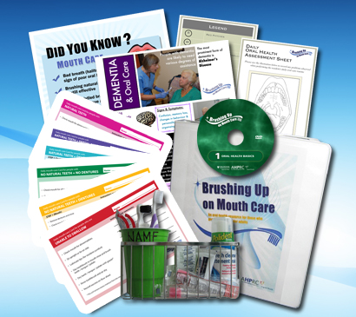
Session 4a
‘Brushing Up on Mouth Care’
Education Series
Audience: All Staff
Implementing an oral care program in
LONG-TERM CARE
Notes:
This is the fourth, and final session in the ‘Brushing Up on Mouth Care’ education program.
We will be discussing how to implement an oral care program in our long-term care facility using the ‘Brushing Up on Mouth Care’ resources.
**Introduce yourself
**Welcome participants

Slide 2
Session 4a
‘Brushing Up on Mouth Care’
Education Series
Audience: All Staff
Permission for use of these materials is for educational purposes only. These materials may not be copied or republished in part or in whole in any form or by any means or media without prior permission from the Brushing Up on Mouth Care team.
Contact us at HPI@dal.ca or (902) 494-2240
Notes:
2
This is session one of the 'Brushing Up on Mouth Care' education series.
We will be discussing the basics of oral health, as well as oral care assessment and care planning.
**Introduce yourself
** Welcome participants

Slide 3
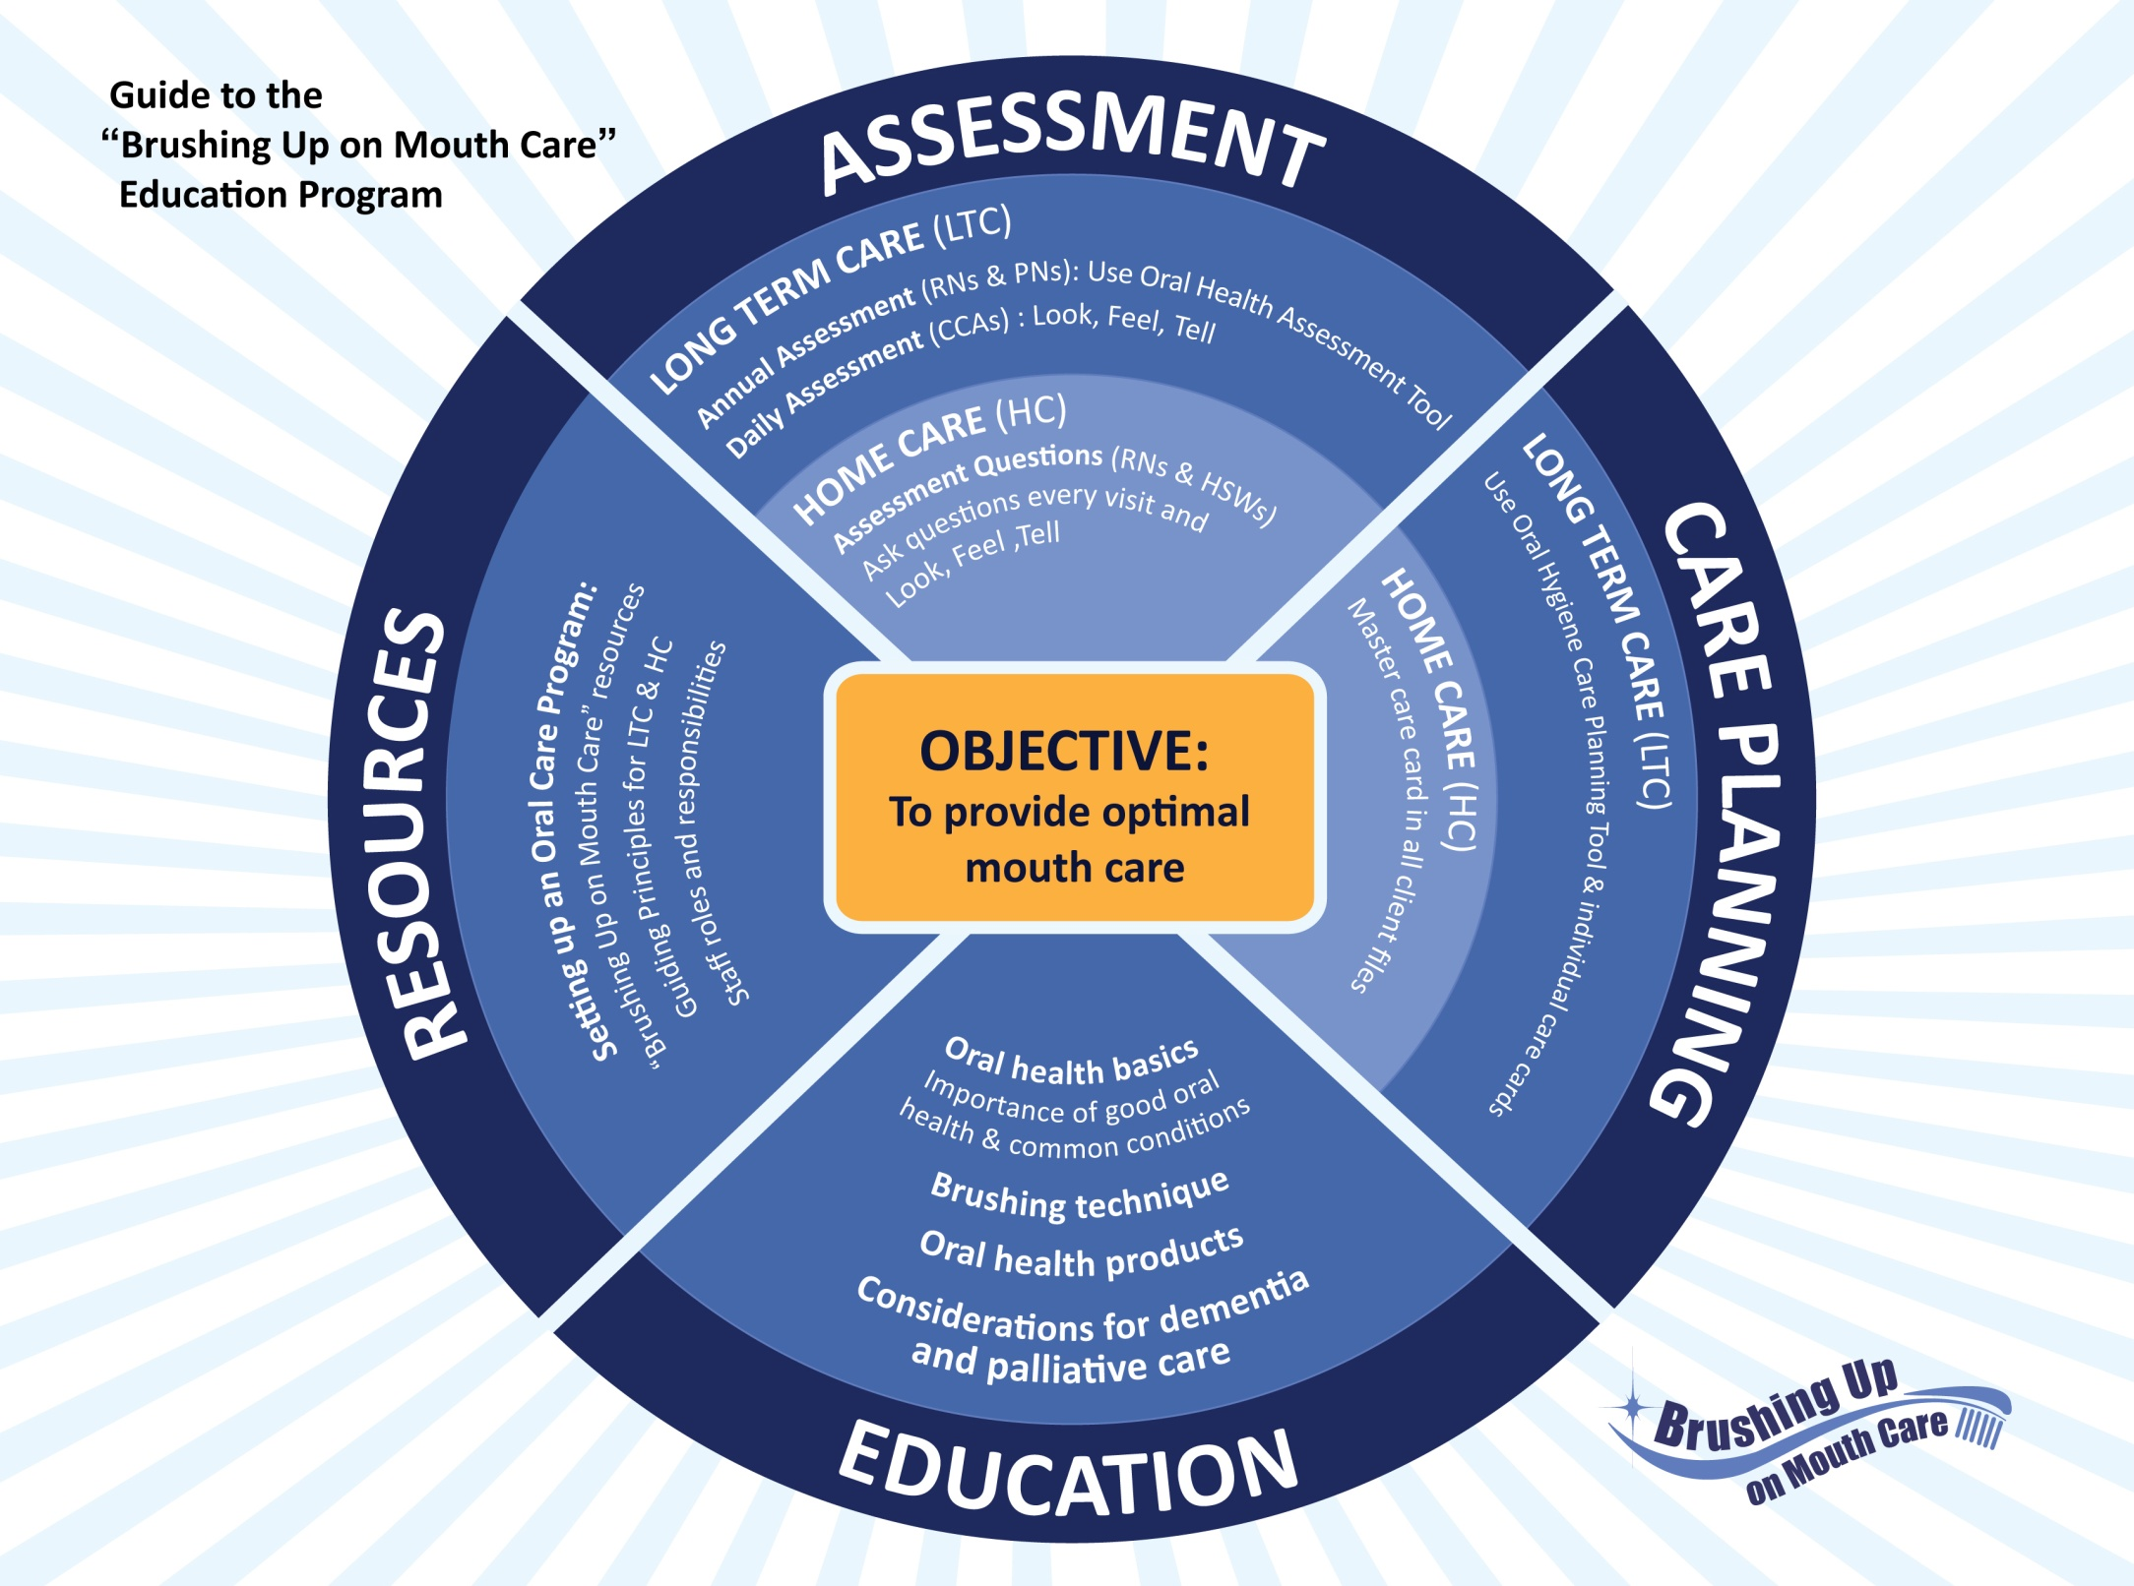
MODEL
Notes:
The ‘Brushing Up on Mouth Care’ program was developed through a research project at Dalhousie University (Faculty of Dentistry and the Atlantic Health Promotion Research Centre) and Capital District Health Authority.
To carry out this research project, researchers worked in partnership with personal care providers, nurse managers and directors of care from three long-term care facilities in rural Nova Scotia. Together, the partners planned, developed, implemented and evaluated a daily oral care program for these facilities. The user-friendly resources that were created to educate and support personal care providers provide the basis for the ‘Brushing Up on Mouth Care’ program.
This model provides a guide to the ‘Brushing Up on Mouth Care’ education program. The overall objective of this program is to provide optimal mouth care for older adults who require assistance with personal care in both long term care and at home. ‘Brushing Up on Mouth Care’ focuses on assessment, care planning, education and resources. These four themes have come up throughout the various education sessions.

Slide 4
Session 4a
Introductions
Logistics
Parking Lot
Introductions
Notes:
**Logistics:
Tell participants the session will take about a hour to complete.
Tell them where washrooms are located (if they are in an unfamiliar location).
Discuss any other logistics (e.g. turn off cell phones/pagers, breaks, etc.)
PARKING LOT:
The ‘Parking Lot’ is a place to record any outstanding questions or issues that arise throughout the session
Mark the words ‘Parking Lot’ on one piece of paper, white board or flip chart
Tell the participants that issues placed in the parking lot will be reviewed at the end of the session
**If participants are not familiar with each other, go around the room and let them introduce themselves.

Slide 5
Overview
Session 4a
Brushing Up on Mouth Care Program
  Overview of resources available
Guiding Principles for Long-Term Care
Roles & Responsibilities
  Nurse Manager/RN
  Care Providers (CCAs & PCWs)
  Oral Care Champion
  Other Long-Term Care Staff Members
  Administrators
Conclusion
  Take Home Messages
Notes:
This session will provide:
An overview of the ‘Brushing Up on Mouth Care’ resources and guiding principles for long-term care.
The guiding principles also include a breakdown of the roles and responsibilities of care team and long-term care staff members in supporting an oral care program.

Slide 6
Session 4a
Learning Objectives
This session will develop knowledge, understanding
and appreciation of:
  Elements of the ‘Brushing Up on Mouth Care’ program
  Guiding principles to assist with the implementation of an oral care program
  Roles and responsibilities of staff members
Notes:
This session will develop knowledge, understanding and appreciation of:
Elements of the ‘Brushing Up on Mouth Care’ program
Guiding principles to assist with the implementation of an oral care program
Roles and responsibilities of staff members

Slide 7

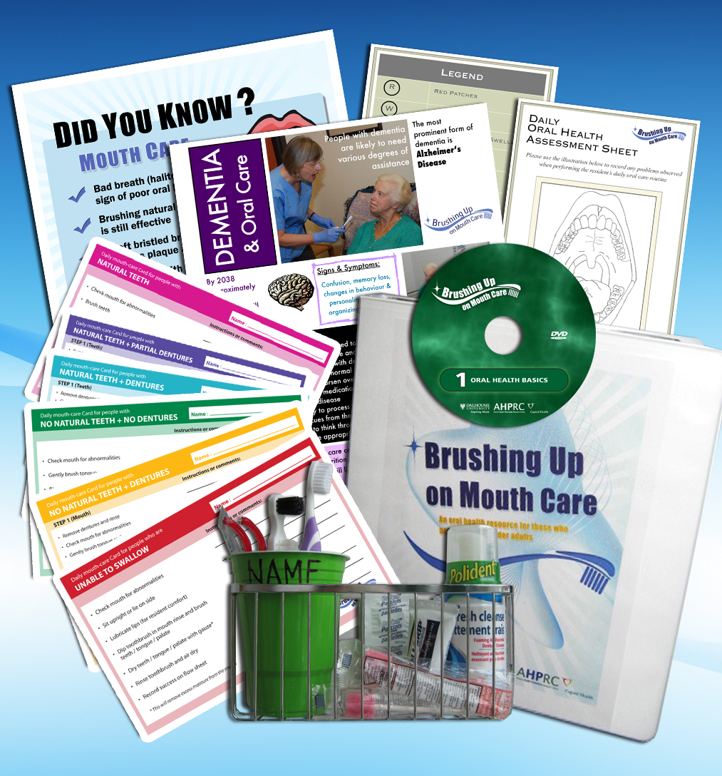
Session 4a
Brushing Up on Mouth Care
Resources
  Do you think this facility is ready to implement an oral care program?
  Why or why not?
Notes:
The ‘Brushing Up on Mouth Care’ resource manual contains a variety of resources for those who provide care to older adults. Resources include information sheets, care cards, posters, assessment and care planning tools, and videos .
We will review these resources and how they can be used in your facility.
**Ask the participants: Do you think this facility is ready to implement an oral care program? Why or why not?

Slide 8


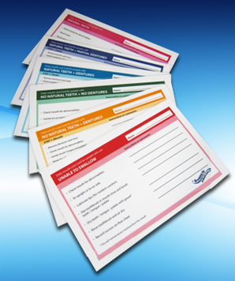
Session 4a
Brushing Up on Mouth Care Resources
Care Cards
= Natural Teeth
= Natural Teeth + Dentures
= Natural Teeth + Partial Dentures
= No Natural Teeth + Dentures
= No Natural Teeth + No Dentures
= Unable to Swallow
Notes:
8
Let’s start with Care Cards…
The Care Cards were developed to create individualized oral care instructions for each resident. Each resident should be given a care card appropriate for his or her needs.
There are six different care cards available that outline the appropriate steps to take when providing oral care to someone with natural teeth, dentures, partial dentures or to someone who is unable to swallow.
The resident’s name should be placed on the front of the card along with any special instructions. For example. personal preferences such as the time of day they prefer to have mouth care done.
Care cards should be stored with or near the oral care supplies.
There are 6 different cards available that outline appropriate steps for oral care depending on the resident’s oral health status (e.g. natural teeth, dentures, etc.).

Slide 9
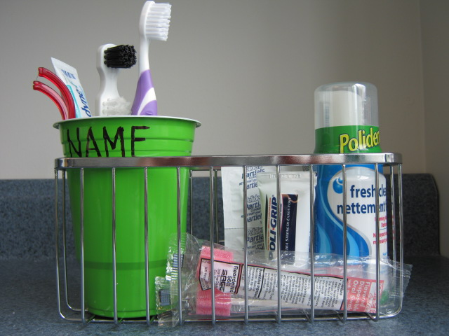
Session 4a
Brushing Up on Mouth Care Resources
Toolkits
Simple design: Deep metal basket with a plastic cup
Cup allows toothbrush to stand upright to dry
Plastic cup can be replaced regularly when dirty
Everything in toolkit should be labeled with resident’s name or initials
Notes:
It is important that oral care supplies are stored together in an appropriate place.
An Oral Health Toolkit should be made for each resident. These toolkits are used to store oral care supplies ONLY. The suggested model includes a metal basket containing a disposable plastic cup. This model was selected for the following reasons:
The basket is portable and provides an easy way to transport oral care supplies into the washroom OR the basket can be mounted to the wall of the washroom
The metal basket is deep enough to hold the plastic cup without fear of it falling over, wide enough to store a denture cup or container, and it is easy to clean. The metal slats will allow moisture to escape.
The plastic cup is easy to label, tall enough to keep the toothbrush upright to dry, and disposable so it can be replaced regularly when it gets dirty.
Everything in the toolkit should be labeled with the resident’s name or initials.

Slide 10
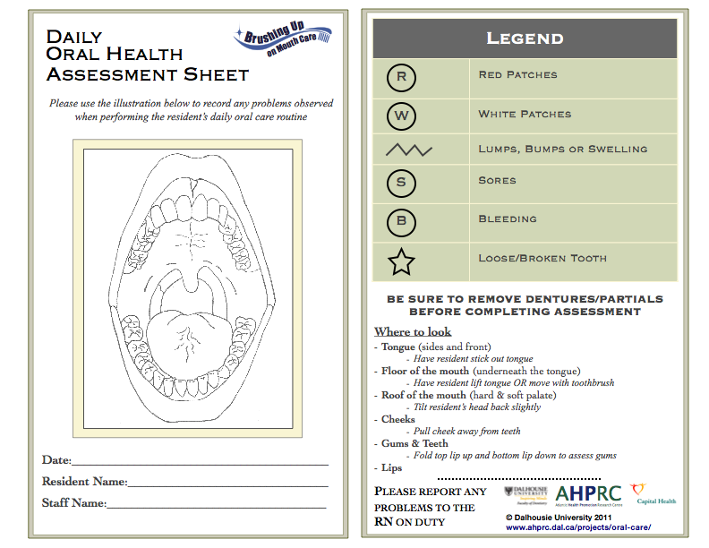
Session 4a
Brushing Up on Mouth Care Resources
Assessment Form (Daily)
Notes:
The DAILY ASSESSMENT FORM is a guide care providers can use when assessing a resident's oral health. Care providers should do a quick check of the resident’s mouth prior to providing oral care (LOOK, FEEL, & TELL). A daily assessment form should only be completed when something abnormal is found.
An abnormality would be considered anything new, or that was not there before. It may present as red or white patches, swelling/lumps, loose teeth, etc.
Using the Daily Assessment Form, care providers can mark on the mouth-diagram what they have noticed and where.
Completed cards are then placed in the resident’s file. This will provide a recorded timeline of any changes occurring in the resident’s mouth.

Slide 11
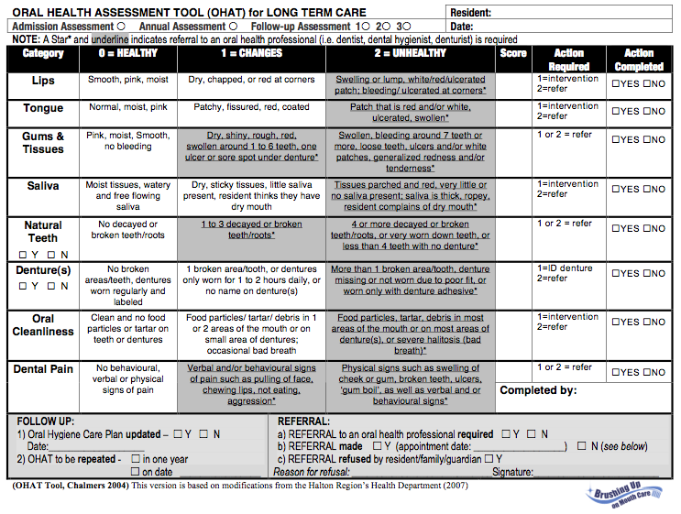
Session 4a
Brushing Up on Mouth Care Resources
Assessment Form (Annual)
Notes:
The Oral Health Assessment Tool is a widely accepted validated tool for assessing various aspects of oral health status. This quick and easy one page document is used to identify common healthy and unhealthy conditions associated with the mouth, tissues, teeth and dentures.
Residents should have their oral health assessed on a regular basis. Each new resident entering the care facility should have their oral health formally assessed.
The Oral Health Assessment Tool should be completed by a member of the nursing staff prior to the development of the resident’s initial care plan.
Residents should also have their oral health assessed annually to coincide with annual care conferences.

Slide 12
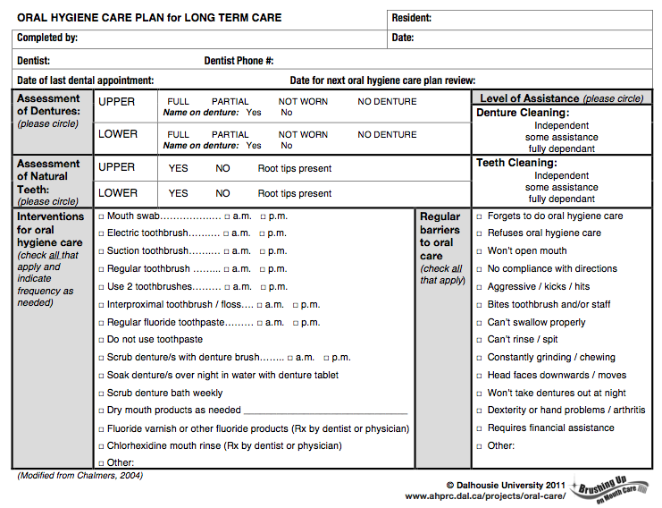
Session 4a
Brushing Up on Mouth Care Resources
Care Planning Tool
Notes:
The ORAL HYGIENE CARE PLAN tool is used to outline what is required to ensure that each resident is receiving appropriate oral care on a daily basis. This care plan should be reviewed and updated each time the Oral Health Assessment Tool is completed. It provides a way for the care team to communicate about the oral care of individual residents and can also provide a record of whether or not progress is being made over time.
A variety of common oral hygiene interventions are itemized to cue the care-provider about best approaches for a particular resident. For example, it may be observed dentures need to be soaked overnight.
An itemized list helps to identify behaviors that might be expected of a particular resident such as “will not open mouth” or “aggressive”. These are noted in order to better prepare the care-provider to deliver oral care.

Slide 13
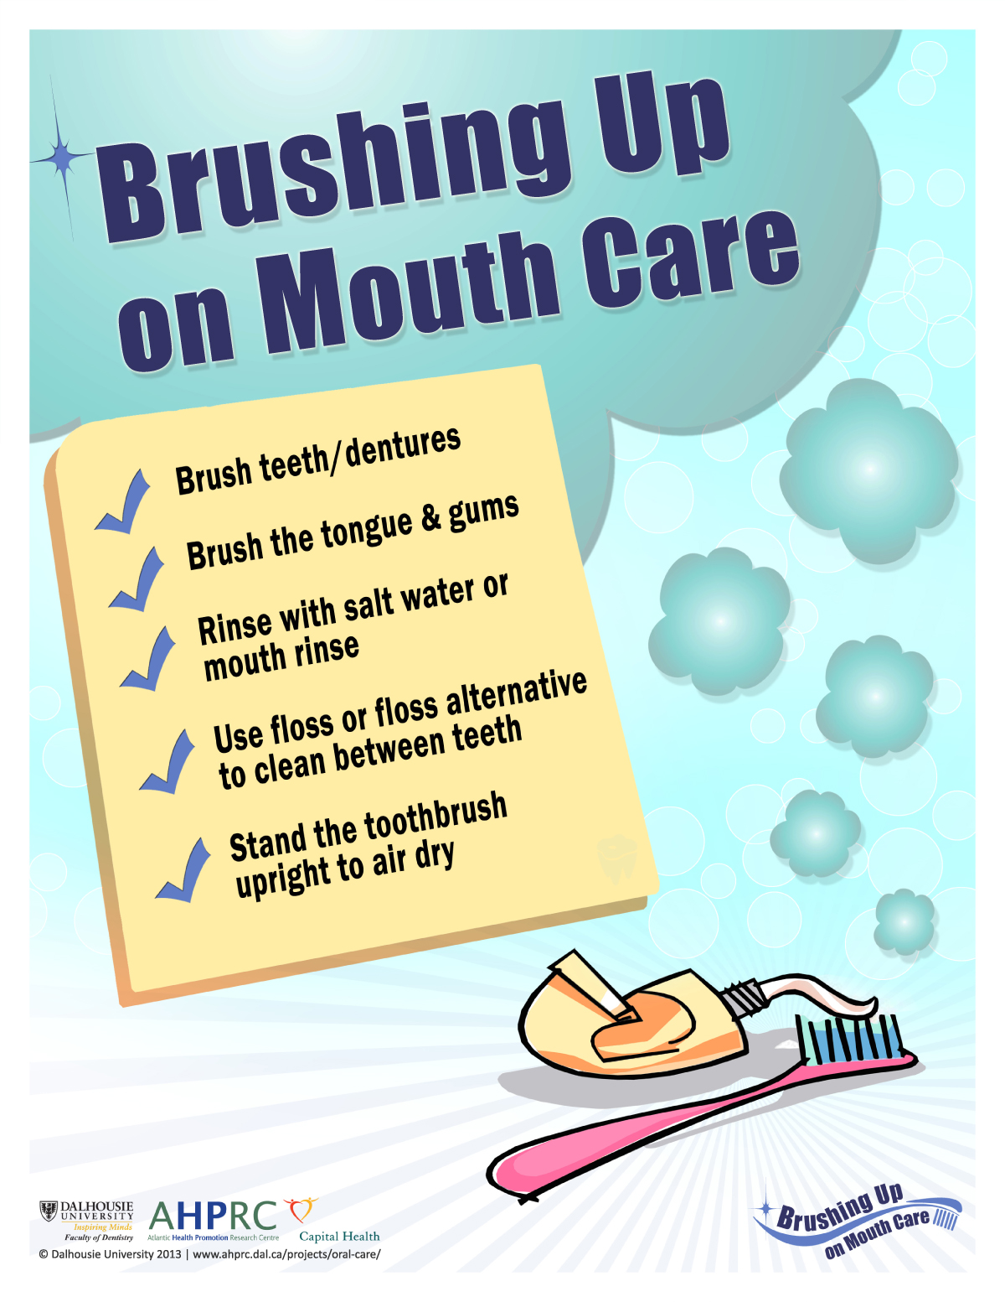
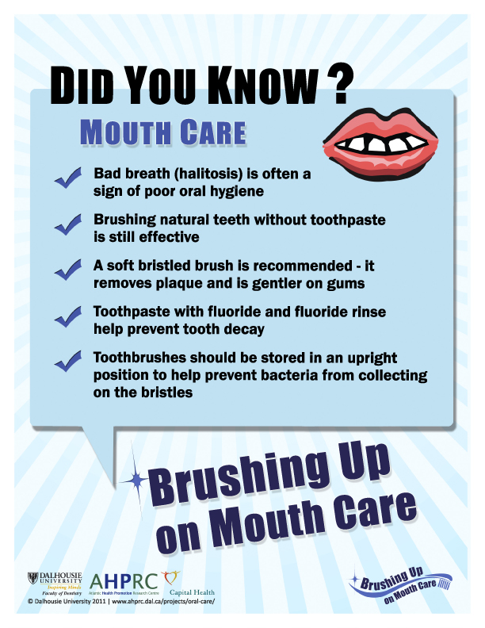
Session 4a
Brushing Up on Mouth Care Resources
Posters
Notes:
‘Visual cues’, like posters, provide a friendly reminder to members of the care team about oral care - similar to hand washing posters.
Posters outlining various aspects of oral care are available in the ‘Brushing Up on Mouth Care’ resource manual.

Slide 14
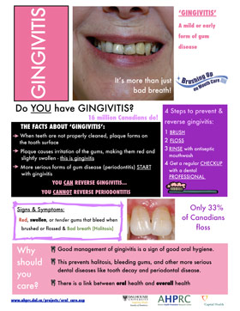
Session 4a
Brushing Up on Mouth Care Resources
Information Sheets
Common Oral Conditions
Dental Caries & Diet
Periodontal Disease
Dry Mouth
Oral Swabs
Palliative Oral Care
Oral Cancer
Oral Care during Cancer Treatment
Denture Care
Dehydration
Taste & Swallowing Disorders
Labeling Dentures
Dementia & Oral Care
Notes:
Information sheets provide background on different topics and conditions affecting oral health. The information sheets listed here are great reference tools for members of the care team and family members.

Slide 15
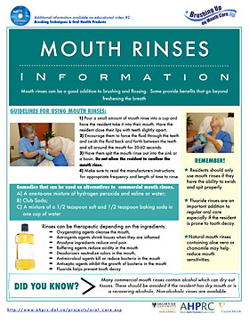
Session 4a
Brushing Up on Mouth Care Resources
Health Products/Aids
Toothbrushes
Floss Aids
Mouth Rinses
Denture Products
Dry Mouth
Canker Sores & Cold Sores
Other Products
Notes:
15
“Oral health products and aids” is a series of handouts that detail proper techniques and products available for brushing, flossing, rinsing, denture care and so on.

Slide 16
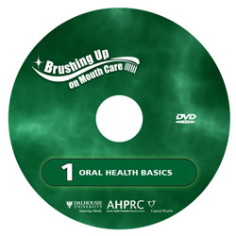
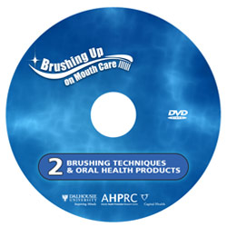
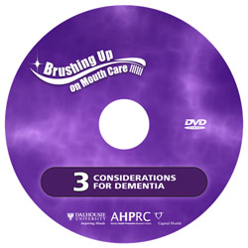
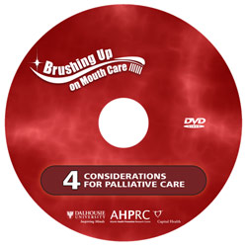
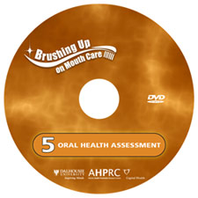
Session 4a
Brushing Up on Mouth Care Resources Educational Videos
Oral Health Basics
Brushing Technique & Oral Health Products
Considerations for Dementia
Considerations for Palliative Care
Oral Health Assessment
Notes:
A series of five educational videos focus on various aspects of providing daily mouth care to older adults. These include:
The Basics of Oral Health
Brushing Technique & Oral Health Products
Considerations for Dementia
Considerations for Palliative Care
Oral Health Assessment
The five videos are provided on DVD in the ‘Brushing Up on Mouth Care’ manual, or they can be viewed directly from the project website.

Slide 17
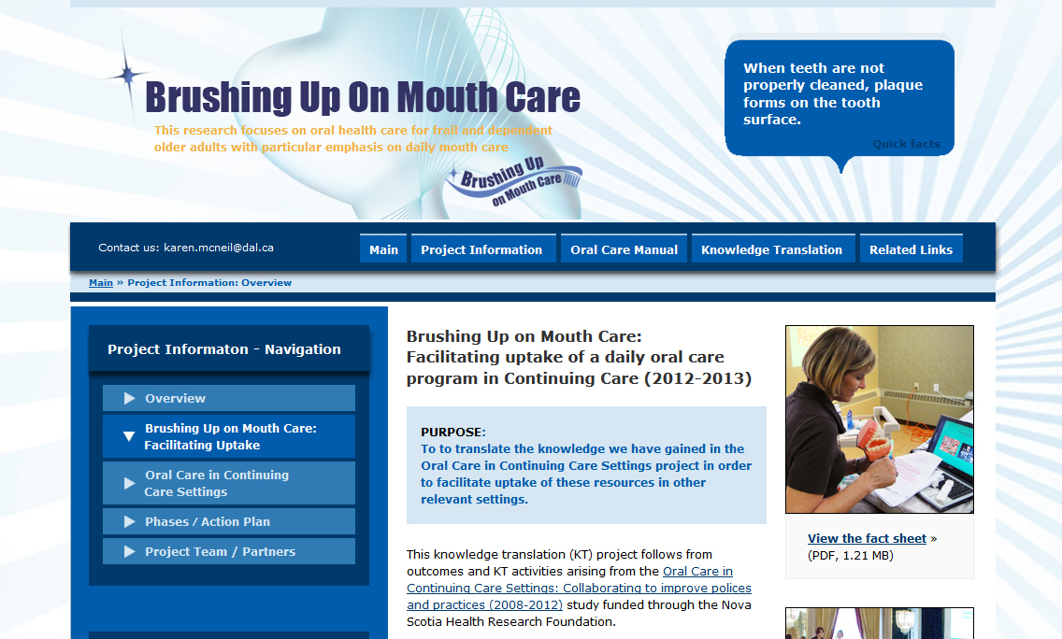
Session 4a
Brushing Up on Mouth Care Resources
Website
http://www.ahprc.dal.ca/projects/oral-care/
Notes:
All materials outlined are available as part of the ‘Brushing Up on Mouth Care’ resource manual and on the project website.
All materials can be downloaded for free from the website - no password or login required.
**This is the last slide for the ‘Brushing Up on Mouth Care’ resources. Next slide announces the break.

Slide 18
Session 4a
Guiding Principles
Aim: to provide a comprehensive approach
for providing daily oral care
Goal: to reduce oral discomfort and
disease in residents
How: provide clear expectations for daily
mouth care while allowing for flexibility
Notes:
**depending on your time, you may wish to give participants a short 5-10 minute break to go to the washroom, fill water bottles, etc.
Any questions about the ‘Brushing Up on Mouth Care’ resources before we move onto Guiding Principles?
The ‘Brushing Up on Mouth Care’ project has developed a set of ‘guiding principles’ for long-term care that may be helpful in providing a comprehensive approach for providing daily oral care.
The goal of these principles is to reduce oral discomfort and disease in residents by providing clear expectations for residents and members of the care team. Because continuing care environments differ from one another, these principles allow for flexibility in how they may be applied.
It is important to note that these guidelines were created by administrators and care providers in continuing care.

Slide 19
Session 4a
Guiding Principles
The goal of oral hygiene is to provide comfort and enhance quality of life
  - e.g: social interactions, nutritional status
Notes:
Guiding Principle #1
The goal of oral hygiene is to provide comfort and enhance quality of life
Quality of life can be greatly diminished when oral health is poor.
Poor oral health can diminish the pleasures of eating and speaking and can cause great discomfort to the resident.
A clean mouth free of bad breath is important for a resident’s social wellbeing.

Slide 20
Session 4a
Guiding Principles
2) Every resident will have optimum daily
mouth care as part of personal care
  Optimum = meeting the resident’s personal
  oral care needs
  Personalized oral care plan
Notes:
Guiding Principle #2
Every resident will have optimum daily mouth care as part of personal care.
Optimum oral care means providing the best care possible to the resident given their specific oral care needs. This should be reflected in their personalized oral care plan.
It is important to offer oral care everyday even if the resident refuses.
For palliative patients, it may be more important to focus on minimizing mouth pain and discomfort.

Slide 21
Session 4a
Guiding Principles
3) The protection of independence and self determination of the resident is a priority in decision-making, but is also about treating residents of all ages as persons worthy of respect
  Oral care delivered with input from resident (“Is this what you want?”)
  Informed choice (risks vs. benefits)
  Resident has a right to receive (and refuse) oral care
Notes:
Guiding Principle #3
The protection of independence and self determination of the resident is a priority in decision-making, but is also about treating residents of all ages as persons worthy of respect
Here we are talking about person-centered care and the autonomy of a person to say what they want or do not want in terms of their care if they are able. Oral care should be delivered with input from resident (“Is this what you want?”)
The resident should be asked to provide input on their oral care plan.
Perceived time constraints by care providers should not infringe on a resident’s right to receive oral care. If a care provider feels they do not have time to provide oral care, that does not mean that the resident does not have a right to receive oral care that day. A resident’s right to receive oral care is always present, should be attended to daily, and must be given equal priority to other essential personal and health care supports.

Slide 22
Session 4a
Guiding Principles
4) An oral health assessment and evaluation will
be completed upon admission and annually thereafter. This assessment will identify oral health needs and guide individualized care planning.
  Oral Health Assessment Tool completed upon admission
  Provides baseline oral health information
  Personal oral care plan developed based on results of assessment
  Oral Health Assessment Tool completed annually thereafter (unless and assessment score indicates more frequent assessments are necessary)
Notes:
Guiding Principle #4
An oral health assessment and evaluation will be completed upon admission and annually thereafter. This assessment will identify oral health needs and guide individualized care planning.
Oral health assessment is important because it provides a record of what is happening with the resident’s oral health over time.
Some residents will come into the facility with poor oral health, the admission assessment provides a record of the ‘starting point’ or baseline for that resident. While oral health may not be able to be improved significantly, at a minimum, appropriate goals must be established.
The information provided by the oral health assessment will guide the oral care planning process. A personal oral care plan should be developed based on results of assessment. The resident’s oral care plan should be updated each time an assessment is completed.
An Oral Health Assessment should be completed annually unless and assessment score indicates more frequent assessments are necessary.

Slide 23
Session 4a
Guiding Principles
5) Each resident will be provided with an oral health toolkit containing a daily mouth care card and supplies appropriate to their needs.
- Toolkit will contain only oral care supplies
- The care card will outline details for each
resident’s daily routine
Notes:
Guiding Principle #5
Each resident will be provided with an oral health toolkit containing a daily mouth care card and supplies appropriate to their needs.
These resources will support care providers in the delivery of daily oral care
The toolkit will contain only oral care supplies
The mouth care card will outline details for each resident’s daily routine
Care cards should be stored with or near the oral health toolkit

Slide 24
Session 4a
Guiding Principles
6) Oral health will be monitored on a daily basis. Any oral health concerns will be reported in a timely manner.
  LOOK, FEEL, TELL
  Daily Oral Health Assessment forms completed to note abnormalities
  Reported to supervisor before the end of shift
Notes:
Guiding Principle #6
Oral health will be monitored on a daily basis. Any oral health concerns will be reported in a timely manner.
Daily assessments by care providers do not need to be time consuming. Care providers should LOOK, FEEL and TELL
Any abnormalities should be noted on the daily assessment form.
Assessments should be completed before oral care is provided.
Any concerns should be reported to a supervisor before the end of shift.

Slide 25
Session 4a
Guiding Principles
7) Nursing staff and care providers will remain up to date on current accepted mouth care practices and will receive a minimum of one continuing education session on mouth care practices in every two year period.
Notes:
Guiding Principle #7
Nursing staff and care providers will remain up to date on current accepted mouth care practices and will receive a minimum of one continuing education session on mouth care practices in every two year period.
This is a suggestion for the frequency of oral health education for staff.
Oral care best practices may change over time and it is important for nursing staff and care providers to be up to date.
IDEAS:
invite dental/ dental hygiene/ dental assisting students in for continuing education sessions
Check for new resource materials through the internet

Slide 26
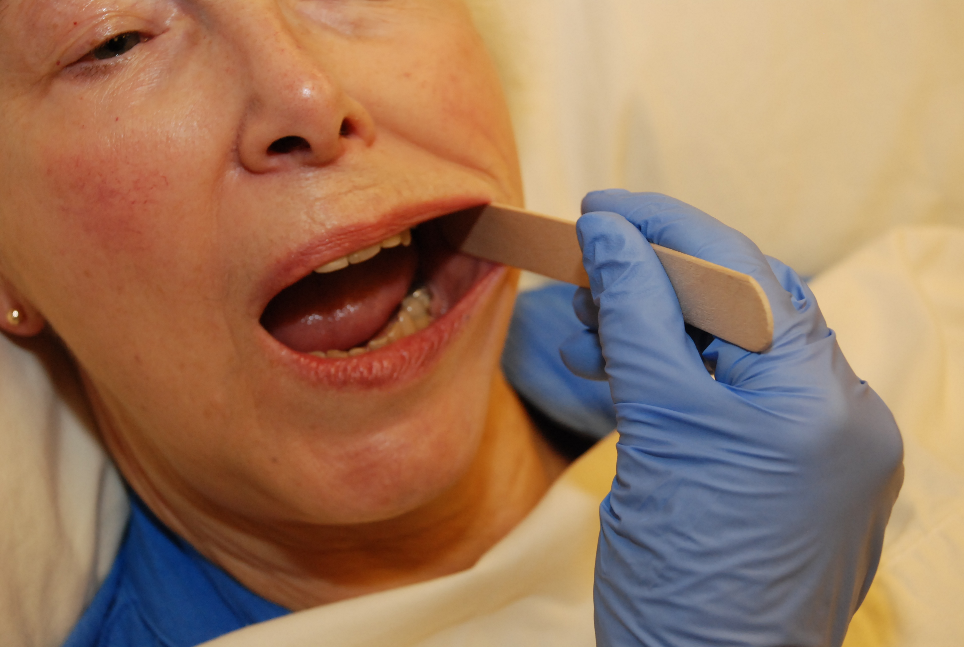
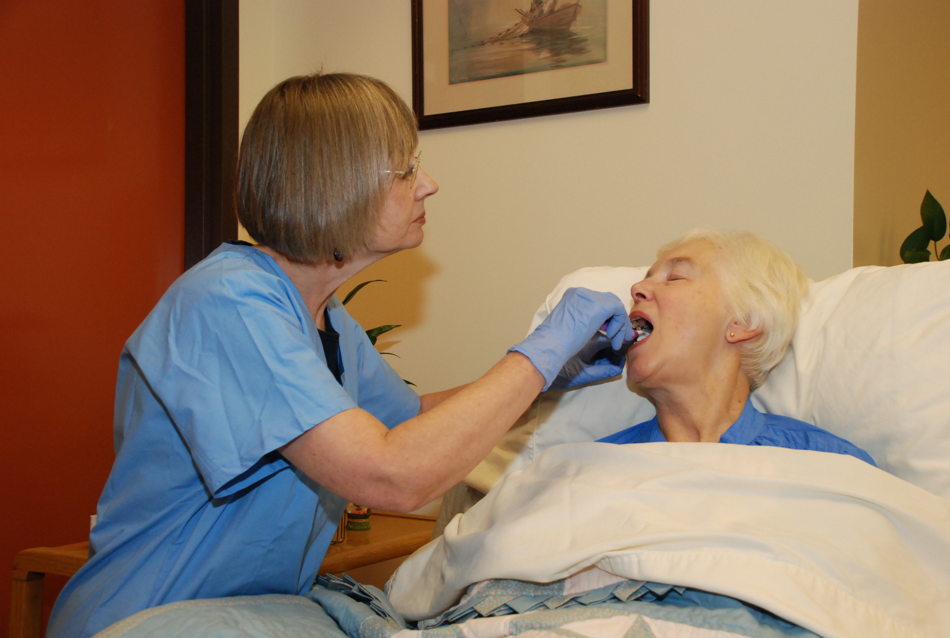
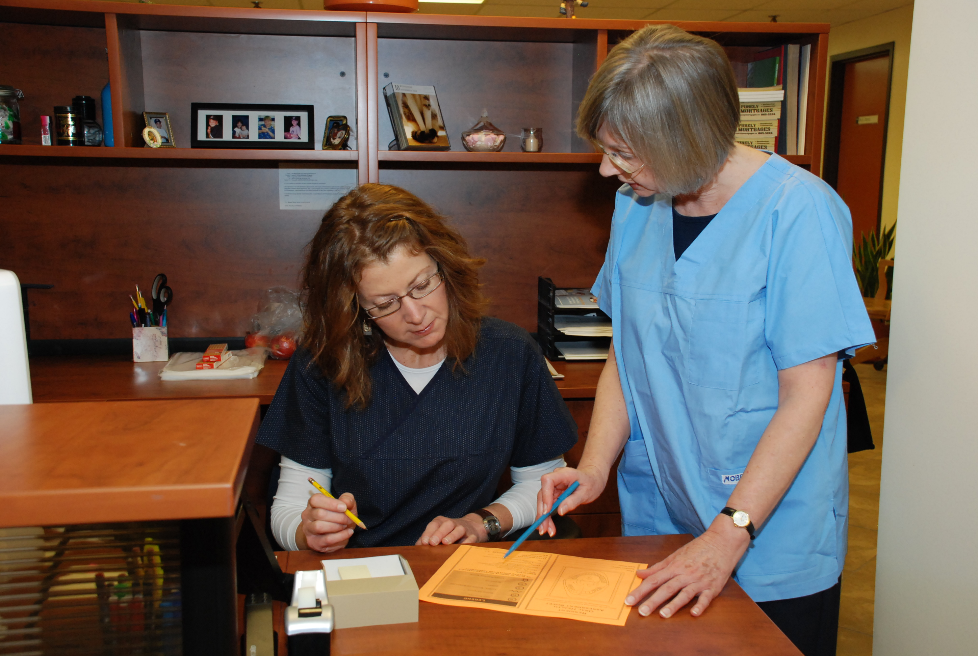
Session 4a
Guiding Principles
Every resident will receive:
  An oral health assessment within three weeks of admission and annually thereafter (unless more frequent assessments are indicated).
  A personalized oral care plan will be developed, and updated after each assessment.
  A review and discussion of their oral care plan at annual care conferences.
  An oral health toolkit to house their personal oral care supplies and a daily mouth care card.
Notes:
26
Every resident will receive:
An oral health assessment within three weeks of admission and annually thereafter (unless more frequent assessments are indicated).
A personalized oral care plan will be developed, and updated after each assessment.
Review and discussion of their oral care plan at annual care conferences.
To be provided with an oral health toolkit to house their personal oral care supplies and a daily mouth care card.

Slide 27
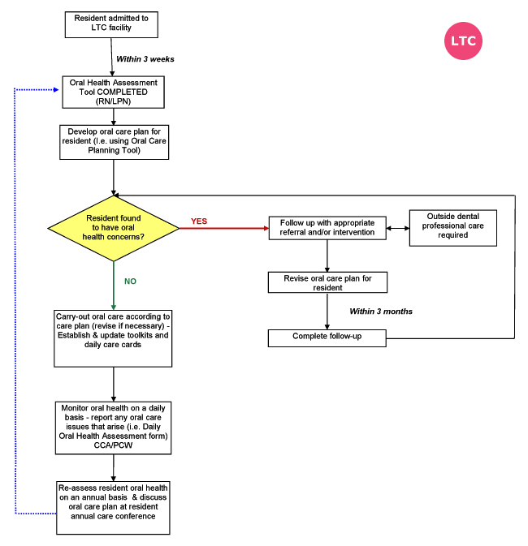
Session 4a
Guiding Principles
For delivering daily oral care to residents
Notes:
27
This is a visual representation of how the oral care program can be put into action
You can see all of the possible pathways a resident may travel depending upon the results of their oral health assessment
For example, Mrs. Smith enters your facility and has an Oral Health Assessment completed her second week. Her assessment indicates that she needs her dentures to be labeled and should be referred to a dental professional to address an unhealthy score in the saliva category (i.e. she is suffering with a very dry mouth). Her family makes arrangements and she is able to see a dentist a month later. The dentist indicates she would benefit from the use of dry mouth toothpaste and saliva substitutes. Her denture is labeled. She is reassessed using the Oral Health Assessment Tool. This time her score indicates minimal oral health concerns. The use of dry mouth products is noted in her oral care plan. Mrs. Smith has her daily oral care carried out as outlined in her oral care plan and does not need to be reassessed until her scheduled annual assessment (which should occur two weeks before her annual care conference).

Slide 28
Session 4a
Roles and Responsibilities
Nurse Manager/RNs
Complete oral health assessments
Orient new staff on oral health best practices
Arrange continuing education sessions on oral care
Arrange for residents to see oral health professional (with assistance of family)
Designate and support an Oral Health “Champion”*
Notes:
The role of the Nurse Manager or RN is to:
Complete oral health assessments
Orient new staff on oral health best practices
Arrange continuing education sessions on oral care
Arrange for residents to see oral health professional (with assistance of family)
Designate and support an Oral Health “Champion”*
The role of the champion is discussed on the next slide.

Slide 29
Session 4a
Roles and Responsibilities
Oral Health Champion
Oversee distribution of oral care cards
Ensure toolkits are stocked, clean and maintained
Ensure oral care supplies are labeled
Change toothbrushes as required
Notes:
In the ‘Brushing Up on Mouth Care’research project it was found that the upkeep of an oral care program was greatly enhanced when an oral care champion was in place. The champion is responsible for the upkeep of the oral health program by ensuring that residents’ have a care card appropriate for their needs, that residents’ toolkits are stocked, cleaned and maintained. The champion would also ensure that each resident’s oral care supplies are labeled and that toothbrushes are replaced regularly.
The champion can be any care provider who is keen and interested in oral health. Some long-term care facilities may choose to rotate responsibilities of the oral care champion.

Slide 30
Session 4a
Roles and Responsibilities
Licensed Practical Nurse (LPN)
Complete oral health assessments
Support RNs, CCAs/PCWs and Oral Care Champion to carry out daily oral care
Act as an oral health champion for residents in their care*
Notes:
The role of the Licensed Practical Nurse is to:
Complete oral health assessments
Support RNs, CCAs/PCWs and Oral Care Champion to carry out daily oral care
In some facilities, Licensed Practical Nurses may be assigned to oversee care for a small number of residents.
In these instances, the LPNs could take on the role of oral health champion for the residents in their care.

Slide 31
Session 4a
Roles and Responsibilities
Care Providers (CCAs & PCWs)
Provide resident daily oral care as outlined in care plan
Check for abnormalities daily
(LOOK, FEEL, TELL)
Report concerns to supervisor in a timely manner
Notes:
The role of the Care Providers (CCAs and PCWs) is to:
Provide resident daily oral care as outlined in care plan
Check for abnormalities daily (LOOK, FEEL, TELL)
Report concerns to supervisor in a timely manner

Slide 32
Session 4a
Roles and Responsibilities
Administrators*
Support the Guiding Principles as key to optimum oral care for residents
Support all staff in their roles & responsibilities
Allot time for continuing education on oral care
Ensure appropriate oral care supplies are available
Monitor assessment and care planning
Notes:
Administrators need to:
Support the Guiding Principles as key to optimum oral care for residents
Support all staff in their roles & responsibilities
Allot time for continuing education on oral care
Ensure appropriate oral care supplies are available
Monitor assessment and care planning
Support from administrators is imperative for the success of any oral care program.

Slide 33
Session 4a
Roles and Responsibilities
Other Long-Term Care Staff Members
Includes: environmental, food & nutrition, recreation staff etc.
Report any concerns regarding resident oral health
  - raised by residents
  - noticed during daily duties
Notes:
Other long-term care staff members such as environmental, food and nutrition and recreation staff, also have a role to play when it comes to oral care.
During daily duties, these staff members may notice that oral care supplies are low or missing, food is not being eaten, or hear a resident raise a concern about their oral health. They can report this to the care providers.
Sometimes dentures will end up in laundry (from being in pockets, etc) and environmental staff can help return them to the resident.
**This is the last slide for Guiding Principles. Next slide outlines ‘Take Home Messages’

Slide 34
Session 4a
Conclusions
Take Home Messages
Brushing Up materials are available on the
project website:
http://www.ahprc.dal.ca/projects/oral-care/
Go big OR start small
Uptake of an oral care program will be unique to each long term care facility
Notes:
All of the ‘Brushing Up on Mouth Care’ materials are available on the project website.
Go Big or Start Small. The resources we have highlighted in this presentation will help to support your activities no matter how you choose to make a difference.
The ‘Brushing Up on Mouth Care’ Program can be rolled out all at once, or you can introduce one component at a time. Uptake will be unique to each long term care facility.

Slide 35
Session 4a
QUESTIONS?
Notes:
Check the ‘Parking Lot’ for lingering issues and questions and address them now

Slide 36
Session 1
Learning Objectives
Did we meet the learning objectives?
This session will develop knowledge, understanding and appreciation of:
  Elements of the‘Brushing Up on Mouth Care’
  program
  Guiding principles to assist with the
  implementation of an oral care program
  Roles and responsibilities
Notes:
Ask participants if they feel they have obtained the required knowledge

Slide 37
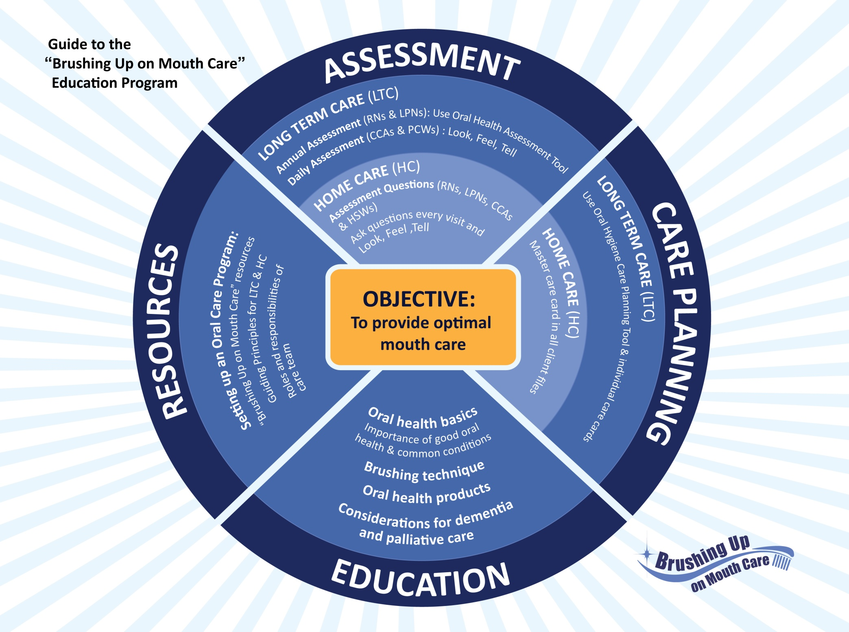
Notes:
This was the last session in the ‘Brushing Up on Mouth Care’ education series.
These four themes - assessment, care planning, education and resources - have come up throughout the various education sessions.
It is now time to take this information and use it to establish a comprehensive approach for providing daily oral care to your residents and to reduce incidences of oral discomfort and disease.
Are there any questions before we conclude?

Slide 38
Session 4a
‘Brushing Up on Mouth Care’
Education Series
Audience: All staff
THANK YOU!
Notes:
Distribute session evaluation forms
Leave a large envelope for participants to place completed forms
Leave the room for 5 minutes to permit participants to submit anonymous evaluation forms

