Slide 1
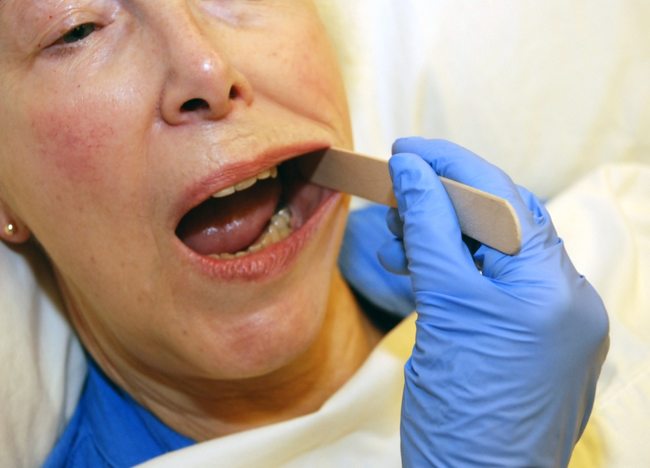
Session 1
‘Brushing Up on Mouth Care’
Education Series
Audience: Long Term Care - RNs & LPNs
Oral Health Basics
Assessment and
Care Planning
Notes:
1
This is session one of the 'Brushing Up on Mouth Care' education series.
We will be discussing the basics of oral health, as well as oral care assessment and care planning.
**Introduce yourself
** Welcome participants

Slide 2
Session 1
‘Brushing Up on Mouth Care’
Education Series
Audience: Long Term Care - RNs & LPNs
Permission for use of these materials is for educational purposes only. These materials may not be copied or republished in part or in whole in any form or by any means or media without prior permission from the Brushing Up on Mouth Care team.
Contact us at HPI@dal.ca or (902) 494-2240
Notes:
2
This is session one of the 'Brushing Up on Mouth Care' education series.
We will be discussing the basics of oral health, as well as oral care assessment and care planning.
**Introduce yourself
** Welcome participants

Slide 3
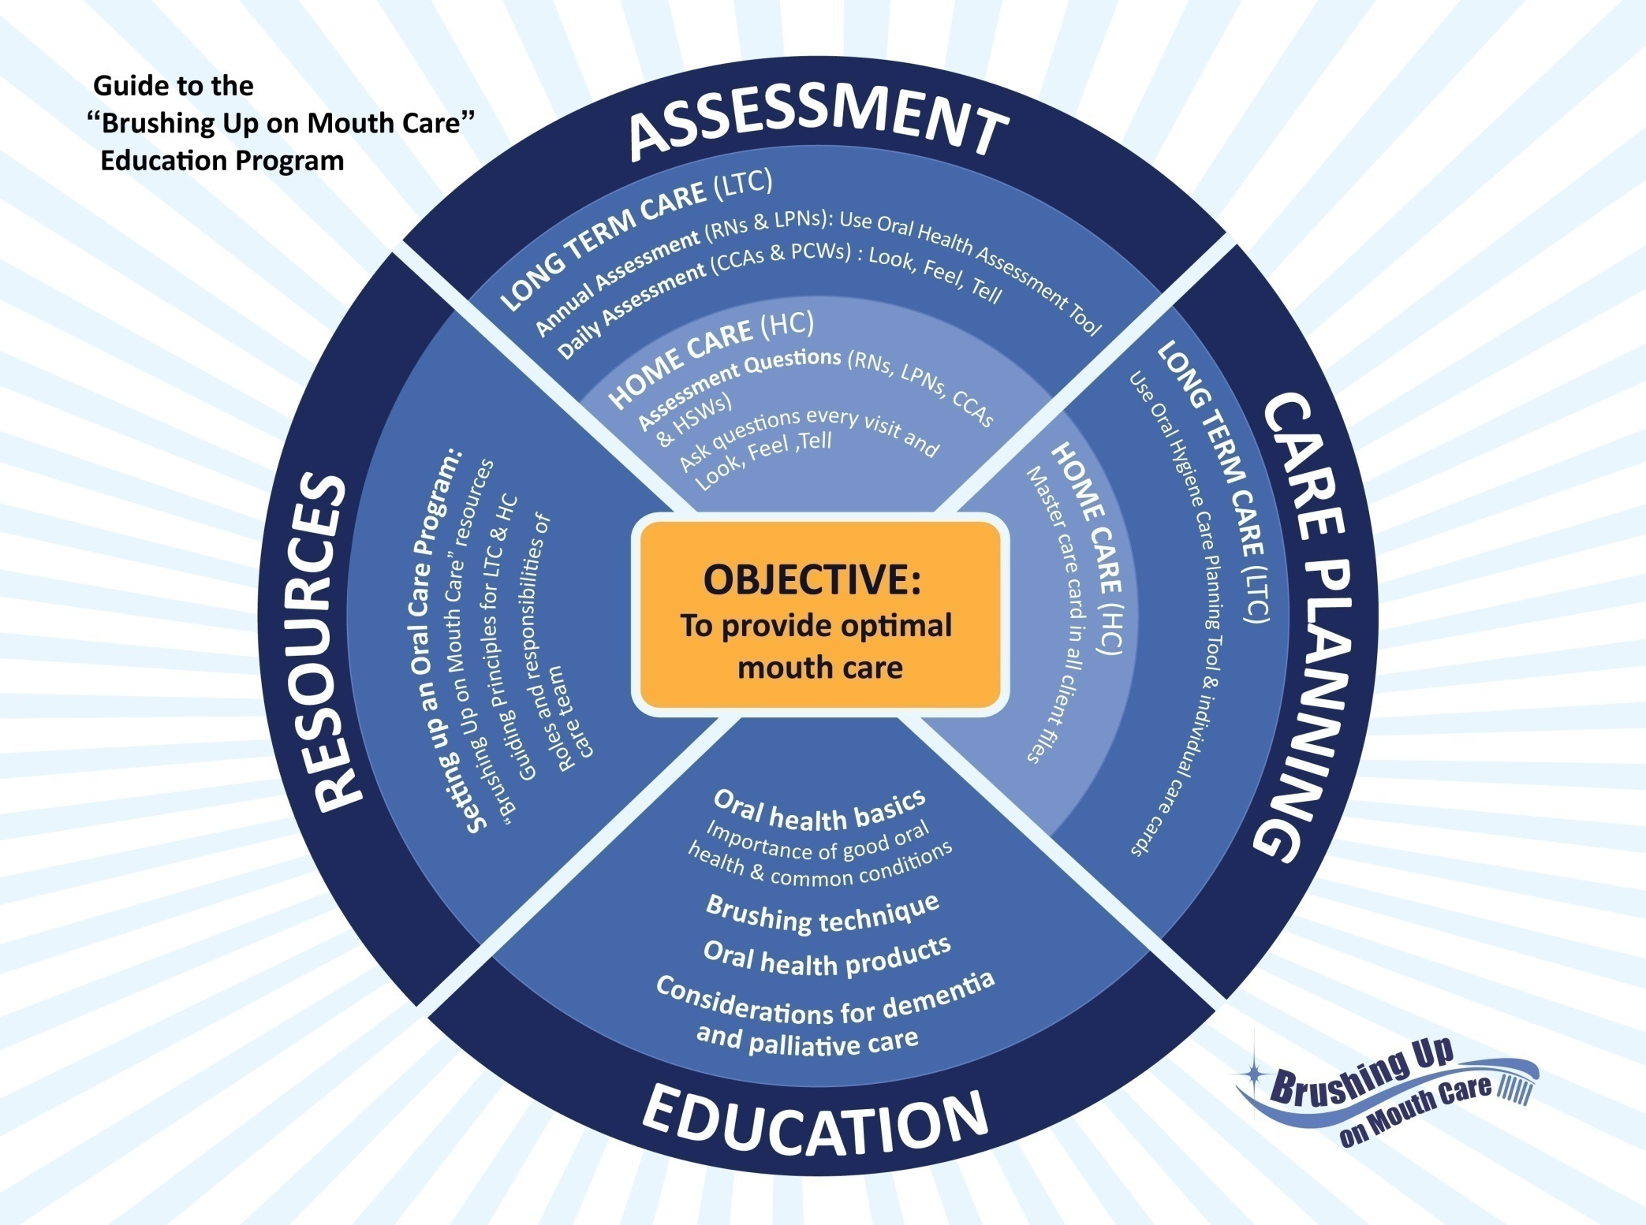
Notes:
3
The Brushing Up on Mouth Care program was developed through a research project at Dalhousie University (Faculty of Dentistry and the Atlantic Health Promotion Research Centre) and Capital District Health Authority. The project was funded by the Nova Scotia Health Research Foundation and the Canadian Institutes of Health Research.
To carry out this research project, researchers worked in partnership with personal care providers, nurse managers and directors of care from three long-term care facilities in rural Nova Scotia. Together, the partners planned, developed, implemented and evaluated a daily oral care program for these facilities. The user-friendly resources that were created to educate and support personal care providers provide the basis for the 'Brushing Up on Mouth Care' program.
This model provides a guide to the ‘Brushing Up on Mouth Care’ education program. The overall objective of this program is to provide optimal mouth care for older adults who require assistance with personal care in both long term care and at home. ‘Brushing Up on Mouth Care’ focuses on assessment, care planning, education and resources. You will see these four themes come up throughout the various education sessions.

Slide 4
Session 1
Introductions
Logistics
Parking Lot
Introductions
Notes:
4
**Logistics:
Tell participants the session will take about a hour to complete.
Tell them where washrooms are located (if they are in an unfamiliar location).
Discuss any other logistics (e.g. turn off cell phones/pagers, breaks, etc.)
PARKING LOT:
The ‘Parking Lot’ is a place to record any outstanding questions or issues that arise throughout the session
Mark the words ‘Parking Lot’ on one piece of paper, white board or flip chart
Tell the participants that issues placed in the parking lot will be reviewed at the end of the session
**If participants are not familiar with each other, go around the room and let them introduce themselves.

Slide 5
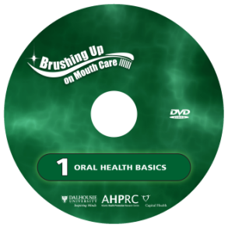
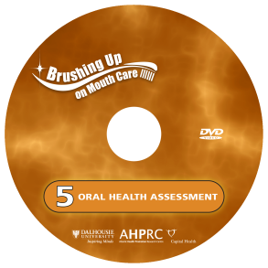
Overview
Session 1
Oral Health Basics
  Importance of Oral Care
  Daily Oral Health Assessment
Assessment & Planning
  Annual Oral Health Assessment Tool (OHAT)
  Oral Care Planning Tool
Conclusion
  Take Home Messages
Notes:
5
In this session we will discuss:
the importance of oral health and how it relates to overall health
the prevention of dental disease
daily oral health assessment and the concept of “Look, Feel, and Tell”
The annual Oral Health Assessment and oral care planning tools will also be reviewed in depth.

Slide 6

Session 1
Learning Objectives
This session will develop knowledge, understanding
and appreciation of:
  Why good oral health is essential for healthy aging
  How to use the Oral Health Assessment and the Oral Care Planning tools to optimize a resident’s oral health
Notes:
6
This session will develop knowledge, understanding and appreciation of:
Why good oral health is essential for healthy aging
How to use the Oral Health Assessment and the Oral Care Planning tools to optimize a resident’s oral health

Slide 7
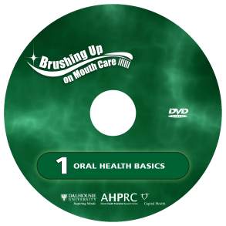
Session 1
Oral Health Basics
Session 1, Part 1
  Do you feel you are providing
  optimal oral care to your residents?
  Why or why not?
Notes:
We will start by reviewing some of the basics of oral health.
More information on oral health basics can be found on video #1 of the Brushing Up on Mouth Care video series.
**Ask the participants: Do you feel you are providing optimal oral care to your residents? Why or why not?

Slide 8
Session 1
Oral Health Basics
Importance of Oral Care
Oral Health and Overall Health
= HAND IN HAND
Poor oral health can lead to:
  Dental cavities
  Gum disease
  Poor nutrition
  Social isolation
  Other health conditions (e.g. pneumonia)
Notes:
8
The population is aging and maintaining natural teeth. This will results in greater challenges for providing oral care.
Oral health and overall health go HAND IN HAND.
The important message here is that the frail elderly population are a high-risk group for oral health problems and need to have proper preventive measures in place.
Frail and dependent people are at high risk of poor oral health if their daily oral hygiene is not maintained. This can lead to:
Dental cavities
Gum disease
Poor nutrition
Social isolation
Other health conditions (like pneumonia)

Slide 9
Session 1
Oral Health Basics
Importance of Oral Care
Teeth are part of the digestive system
  Fewer teeth = Difficulty chewing
  Difficulty chewing = Poor digestion
  Poor digestion = Poor nutrition
  Poor nutrition = Poor health
Poor oral health = Poor health
Notes:
9
The teeth are the beginning of the digestive system.
The food enters the mouth and the saliva glands are activated. The saliva softens the food as the teeth grind and mash causing the food to break apart into smaller particles.
The tongue then pushes the small particles to the back of the mouth to be swallowed.
Therefore, the fewer teeth the resident has - the less chewing they can do. The food is not ground into small particles so the digestive system has to work harder and may not be able to properly digest. This creates problems with nutrition which leads to reduced health.
Some residents may pocket food in their mouths which could be the result of an inability to chew adequately to allow food to be swallowed.
The bottom line is, poor oral health = poor health.

Slide 10
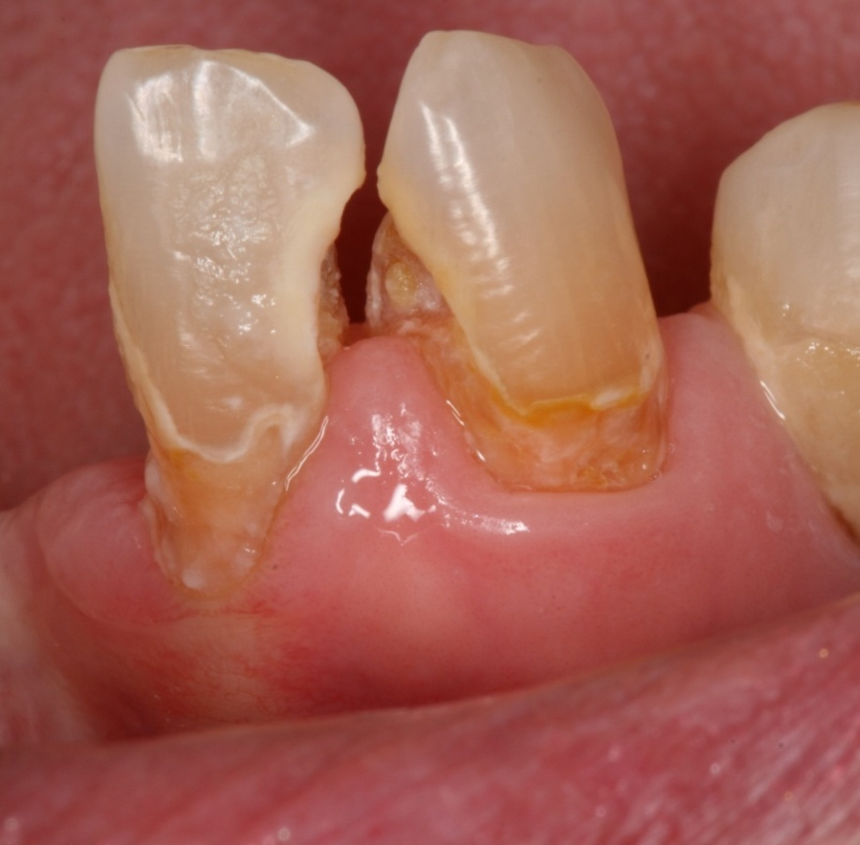
Session 1
Oral Health Basics
Importance of Oral Care
Dental Cavities
Sugar causes cavities
Acid results from eating sugar and starchy foods
Acid attack lasts 5-15 minutes after eating
Acid softens tooth enamel forming cavities
Eating sweets with meals is better than between meals
Notes:
10
If there was no sugar there would be fewer cavities
Each time you eat food that contains sugar or starch, bacteria in the mouth break down this sugar and starch to produce acid. This acid attacks and softens tooth enamel for 5-15 minutes each time you eat.
Cavities develop when the enamel on your teeth is destroyed with repeated acid attacks.
When residents snack on sweets throughout the day, their mouth stays acidic for long periods of time. This allows for cavities to form on the teeth.
Eating sweets with meals is better than between meals.

Slide 11
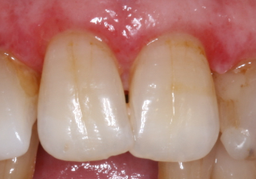
Session 1
Oral Health Basics
Importance of Oral Care
Gingivitis OR Gum Disease
Inflammation caused by bacteria found in plaque
Causes red, swollen, bleeding gums (no pain)
Can be reversed but can lead to periodontal disease if left untreated
Notes:
11
Gingivitis or gum disease is very common. It is an inflammation of the gums that causes the gums to become red and swollen.
Gingivitis is caused by bacteria found in plaque, the sticky film on the teeth. This plaque forms on the teeth and around the gums, and it can also form on dentures.
Plaque forms on the teeth everyday and therefore needs to be removed everyday.
Gingivitis can be reversed with daily mouth care.
If the resident’s gums bleed when brushed, they likely have gingivitis.
This bleeding will decrease with regular brushing.
If plaque is not removed with daily mouth care, gingivitis can lead to periodontal disease; a more serious problem.

Slide 12
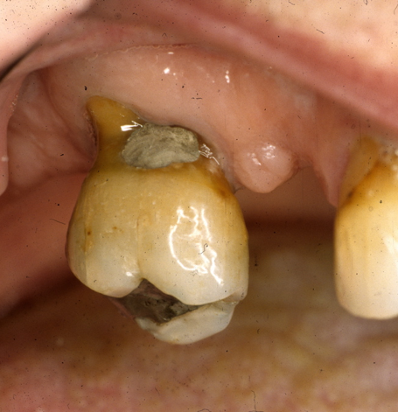
Session 1
Oral Health Basics
Importance of Oral Care
Periodontal Disease
Leading cause of tooth loss in adults
Causes the bone surrounding the teeth to break down
Has been linked to heart disease, stroke, diabetes & pneumonia
Notes:
12
Periodontal disease is the leading cause of tooth loss in adults. This is because the bone around the teeth breaks down and can no longer support the teeth in the jaw.
While gingivitis can be reversed, periodontal disease cannot. Once the bone has been lost it cannot be regained or built up except by special surgery.
Periodontal disease has been linked to heart disease, stroke, diabetes and pneumonia.
Managing gingivitis with daily mouth care is the most important step for preventing more serious gum disease.

Slide 13
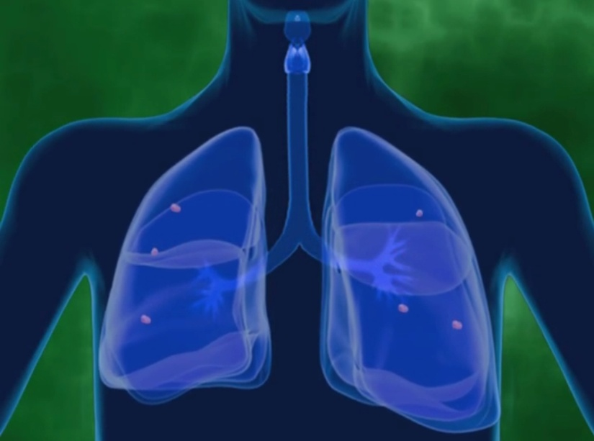
Session 1
Oral Health Basics
Importance of Good Oral Health
Pneumonia
Effective daily mouth care has been shown
to reduce the risk of pneumonia for frail
older adults
Notes:
13
Older adults with poor oral hygiene may have a higher risk of developing pneumonia because plaque and bacteria in the mouth can be inhaled into the lungs. Having bacteria in the lungs can lead to pneumonia.

Slide 14
Session 1
Oral Health Basics
Effective Oral Care
Steps for optimal oral care:
Brush regularly
Floss and use mouth rinse when possible
Have a yearly dental check up
Eat a healthy balanced diet
Limit sugary snacks and drinks
between meals
Notes:
14
Steps for optimal oral care include brushing, flossing, regular dental checkups, and a healthy diet with limited amounts of sugary snacks and drinks.
Brushing after every meal is recommended. All residents should have their teeth brushed thoroughly at least once each day. Brush with a soft toothbrush to help to stimulate gums and keep teeth healthy.
Floss each day when possible. Rinse with alcohol free mouth rinse, preferably one with fluoride. Many residents have dry mouths and using mouth rinses with alcohol can make this worse.
Ideally, residents should have a dental check up once a year.
Encourage residents to eat a healthy balanced diet.
While limiting sugary snacks and drinks may be difficult, they should be consumed with meals when possible.

Slide 15
Session 1
Oral Health Basics
Effective Oral Care
DAILY ASSESSMENT:
Encourage care providers to LOOK, FEEL, TELL every time oral care is done
Remove any dentures before providing oral care
Notes:
15
The main message here is to LOOK, FEEL, and TELL.
Providing daily oral care to residents also presents an important opportunity to check the mouth for any changes or abnormalities.
Encourage the care providers to use this opportunity to look for any abnormalities.
Remove any dentures and before providing daily oral care, do a quick ‘check’ of the resident’s mouth - look at teeth, gums, tongue, roof & floor of mouth, inside of cheeks, and lips
Look for any abnormalities such as red or white patches, swelling, lumps, or loose teeth
Have residents check their own mouth if possible
Care providers should check for residents who are unable to check themselves

Slide 16
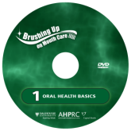
Session 1
Oral Health Basics
Effective Oral Care
DVD 1
Oral health assessments (runs 2:58)
Notes:
16
We will now watch a 3 minute video clip about daily oral health assessment.
**Click on the link to open the video in YouTube
**This is the last slide for Oral Health Basics. Next slide announces the break.

Slide 17
Session 1
Oral Health Assessment
& Care Planning
Session 1, Part 2
Notes:
17
**depending on your time, you may wish to give participants a short 5-10 minute break to go to the washroom, fill water bottles, etc.
Any questions about Oral Health Basics before we move on?
More information on oral health assessment and care planning can be found on video #5 of the Brushing Up on Mouth Care video series.

Slide 18
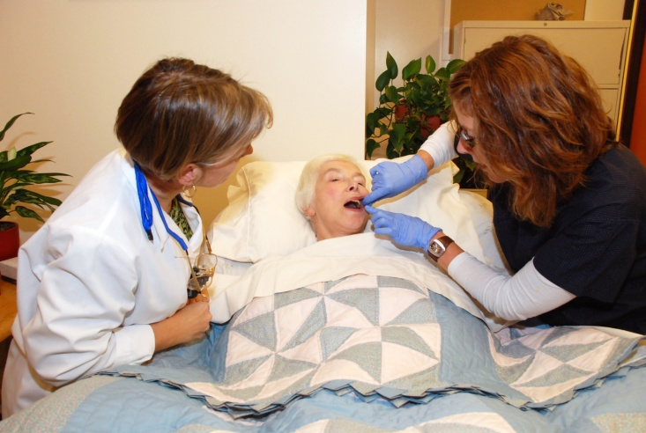
Session 1
Oral Health Assessment
Notes:
18
We will now discuss formal oral health assessment tools and procedures.

Slide 19
Session 1
Annual Oral Health Assessment
Purpose
A resident’s oral status should be assessed routinely and methodically on a regular basis
(i.e. annually and after referrals)
WHY?
To develop and update their oral hygiene
care plan
To determine if a referral is necessary
To provide a record of their oral health status over time
Notes:
19
A resident’s oral status should be assessed routinely and methodically on a regular basis
Each new resident entering a care facility should have an assessment completed prior to the development of their initial care plan.
All residents should have their oral health assessed annually by a member of the nursing staff. These assessments will help to determine if referral to a dental professional is necessary and will provide a record of their oral health over time.
Ideally annual assessments should be completed to coincide with annual care conferences.

Slide 20
Session 1
Annual Oral Health Assessment
Tool Overview (OHAT)
WHO?
RN or LPN
WHEN?
  within 3 weeks of admission and annually thereafter
WHAT?
  a validated tool
  provides guidance to care planning
Notes:
20
Oral health assessments should be completed by a member of the nursing staff – an RN or LPN within 3 weeks of a resident being admitted to the facility and annually thereafter.
The Oral Health Assessment Tool (OHAT) is a quick and easy one page document used to identify common healthy and unhealthy conditions associated with the mouth tissues and dentures.
This is a validated tool - meaning it has been tested with thousands of health professionals to ensure consistency
The OHAT has 8 categories:
LIPS
TONGUE
GUM & TISSUES
TEETH
DENTURE(S)
SALIVA
ORAL CLEANLINESS
DENTAL PAIN

Slide 21
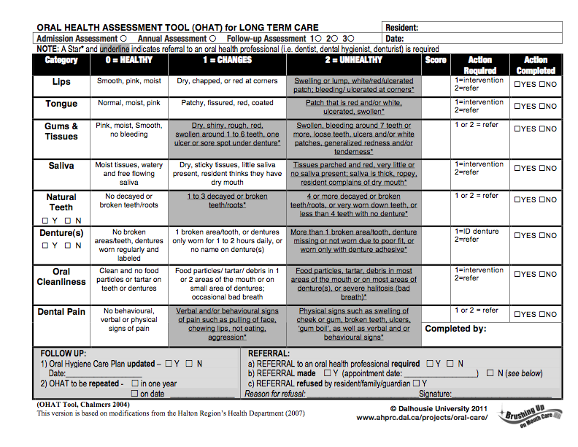
Session 1
Annual Oral Health Assessment
Tool Overview (OHAT)
Notes:
21
We will now watch two video clips about the Oral Health Assessment tool.
**DISTRIBUTE COPIES of the OHAT to participants

Slide 22
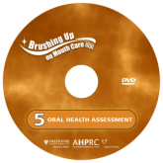
Session 1
Annual Oral Health Assessment
Using the OHAT
DVD 5
How to use the OHAT (runs 4:59)
Notes:
22
The first video clip discusses how to use the Oral Health Assessment Tool
**Participants should have a copy of the Oral Health Assessment Tool to follow along with the video clip.
**Click on the link to open the video in YouTube

Slide 23
Session 1
Annual Oral Health Assessment
Using the OHAT
DVD 5
The OHAT (runs 16:03)
Notes:
23
This next clip is about 16 minutes and reviews the tool in detail.
**Participants should have a copy of the Oral Health Assessment Tool to follow along with the video clip.
**Click on the link to open the video in YouTube

Slide 24
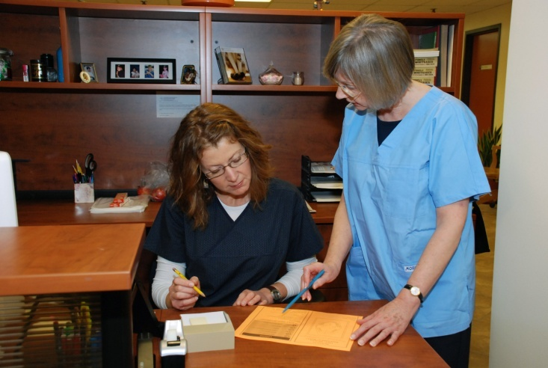
Session 1
Oral Care Planning
Notes:
24
We will now discuss oral health care planning tools and procedures.

Slide 25
Session 1
Oral Care Planning
Tool Overview
WHO?
  RN or LPN
WHEN?
  Reviewed and updated each time an Oral Health Assessment is completed
WHAT?
  A tool that provides guidance to oral care planning
Notes:
25
A member of the nursing staff should review and update a residents oral care plan each time an oral health assessment is completed.
The Oral Care Planning Tool provides guidance to oral care planning. It can be used to outline what each resident will need to ensure they are receiving adequate and appropriate oral care on a daily basis.
It identifies what helps and hinders mouth care for each resident and provides an opportunity for the care team to communicate about a resident’s oral care needs.

Slide 26
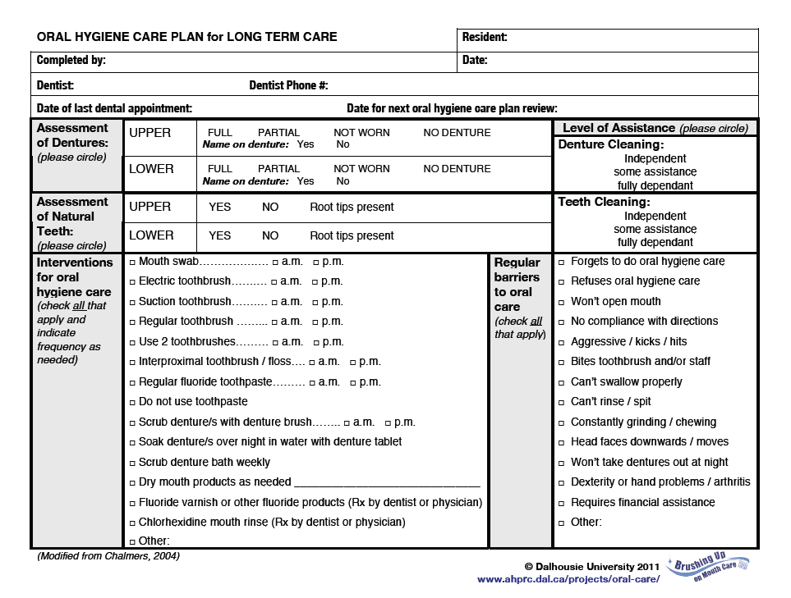
Session 1
Oral Care Planning
Tool Overview
Notes:
26
**DISTRIBUTE COPIES of oral care planning tool

Slide 27
Session 1
Oral Care Planning
Providing Oral Care
DVD 5
Oral Hygiene Care Planning Tool
(runs 4:13)
Notes:
27
We will now watch a brief video clip about the Oral Hygiene Care Planning Tool.
**Each participant should have a copy of the care plan to follow along with the video clip.
**Click on the link to open the video in YouTube

Slide 28
Session 1
Case Study
Mrs. Fraser is an 81 year old woman who has been living on her own for the past 5 years.
.
She has entered your care facility because of advanced Parkinson’s disease.
She is eating a modified diet, having complained, “My teeth are loose and they hurt when I eat something hard or chewy”.
She mostly wears her upper denture.
She puts her lower partial denture in rarely and only when socializing.
Notes:
28
We will now complete a case study activity. You can work in groups of two.
Please take a moment to read the Case Study above. I will then show you a series of pictures. Please complete the Oral Health Assessment tool based on the information provided and what you see in the pictures.
**Ensure all participants have a copy of the OHAT.
**Once participants have read the case study, move on to the next slide.

Slide 29
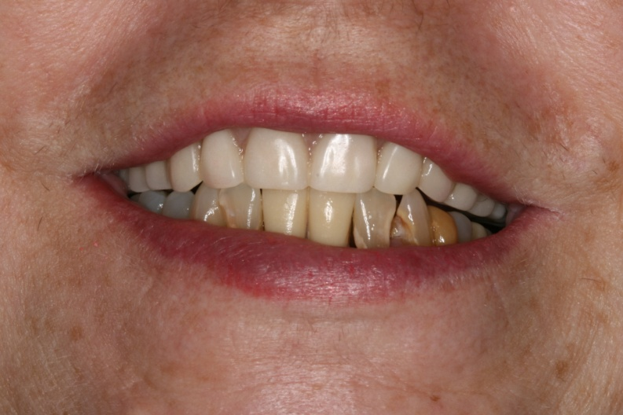
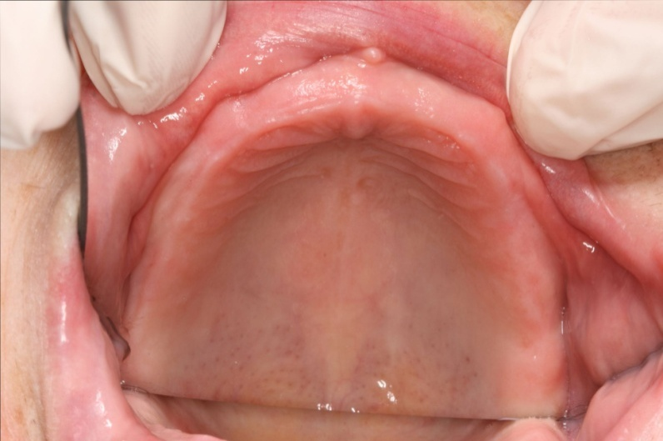
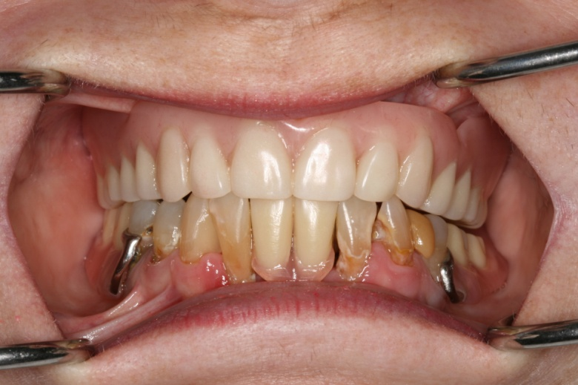
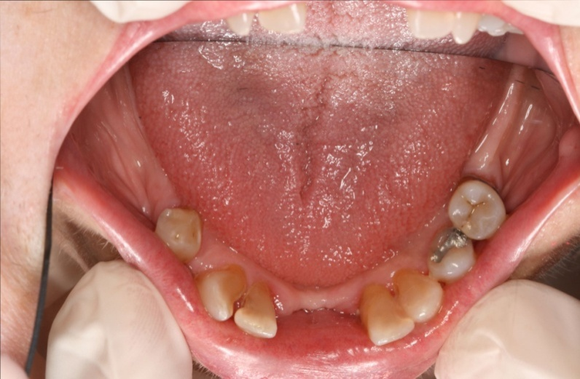
Session 1
Case Study
Notes:
29
**Show participants this slide for 2-3 minutes and let them complete the Oral Health Assessment in pairs.

Slide 30
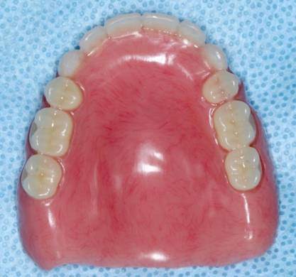
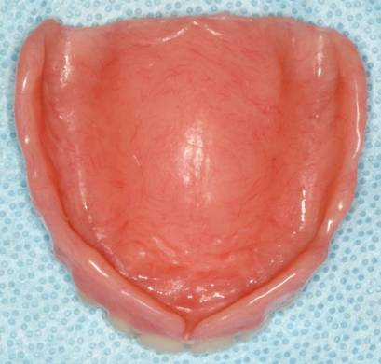
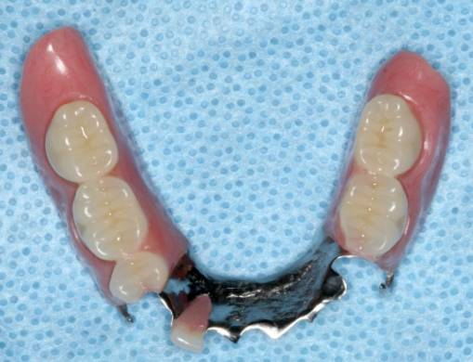
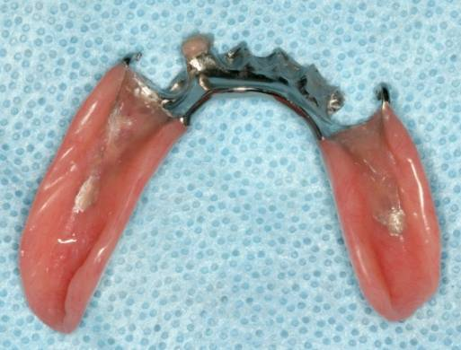
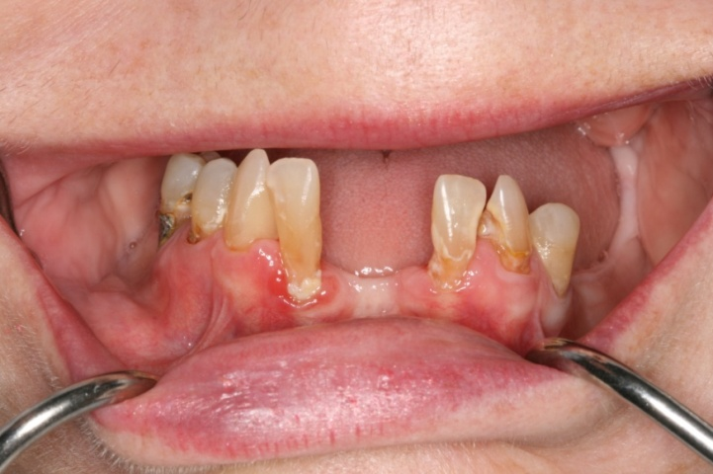
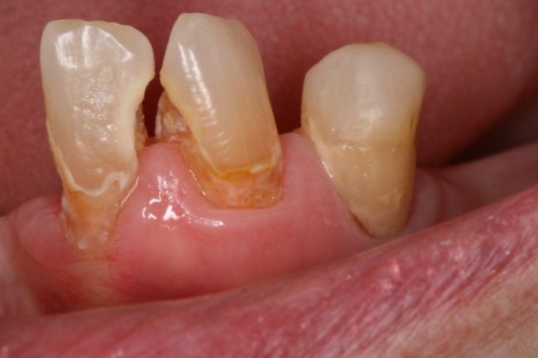
Session 1
Case Study
Notes:
30
**Show participants this slide for 2-3 minutes and let them complete the Oral Health Assessment in pairs.

Slide 31
Session 1
Case Study - Debrief
1
2
3
4
Notes:
31
**Ask participants what information they can gather about Mrs. Fraser’s oral health from each picture.
Picture 1: Shows Mrs. Fraser’s lips. They appear healthy (i.e. smooth, pink and moist).
Picture 2: Shows the roof of Mrs. Fraser’s mouth. This would be part of our examination of her gums and tissues.
Picture 3: Shows Mrs. Fraser’s teeth. What do you notice in this picture? She has an upper and lower denture.
Picture 4: Shows Mrs. Fraser’s tongue. It appears to be healthy (i.e. normal, moist and pink).

Slide 32
Session 1
Case Study - Debrief
5
6
7
8
Notes:
32
**Ask participants what information they can gather about Mrs. Fraser’s oral health from each picture.
Picture 5: Shows Mrs. Fraser’s upper denture. It does not appear broken but we can see her name is not on the denture.
Picture 6: Shows Mrs. Fraser’s lower partial denture. Again it does not appear broken but from our previous description we know she rarely wears this denture.
Picture 7: Shows Mrs. Fraser’s teeth and gums. What do you notice in this picture? We see the gums are red and swollen around the teeth. There also appears to be tartar and calculus build up on the tooth.
Picture 8: Shows more of Mrs. Fraser’s teeth. You can see plaque and calculus build up on the teeth and a large cavity between the two teeth.

Slide 33
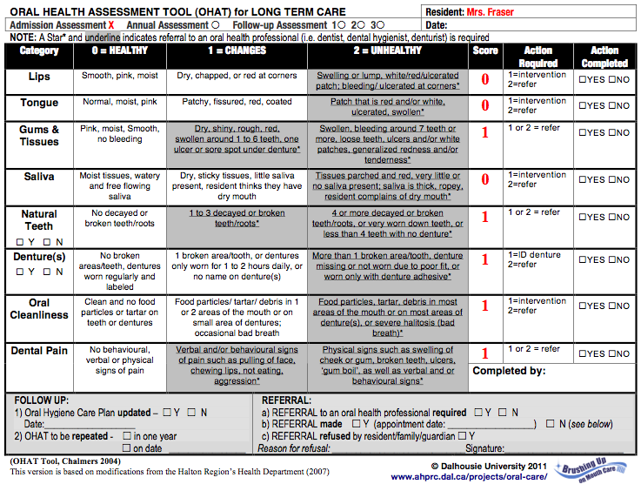
Session 1
Case Study
x
Notes:
So how does Mrs. Fraser score overall?
**Discuss each category with participants before revealing the appropriate score. Each time you click to advance the slide, the correct response and corresponding score for each category will be revealed.
We see that Mrs. Fraser will require a referral as well as some other interventions like labeling her denture.
Once the referral has been made and the denture labeled, this should be identified in the ‘Action Completed’ column.

Slide 34
Session 1
Oral Care Planning
CASE STUDY DISCUSSION
Notes:
**Ask participants how they found the exercise. Did everyone get the same scores? Is it something they feel they could adopt into practice at their facility?
**This is the last slide for Assessment. Next slide outlines ‘Take Home Messages’.

Slide 35
Session 1
Conclusions
Take Home Messages
Oral health plays an important role in overall health
It is important to monitor oral health and check for abnormalities DAILY
Oral health should be formally assessed and care plans updated annually
All members of the care team have an important role to play to improve oral care
Notes:
35
Let’s review the take home messages from this session:
Oral health plays an important role in overall health
It is important to monitor oral health and check for abnormalities DAILY
Oral health should be formally assessed and care plans updated annually
All members of the care team have an important role to play to improve oral care

Slide 36
Session 1
QUESTIONS?
Notes:
36
Are there any questions before we wrap-up?
**Check the “Parking Lot” for lingering issues and questions and address them now.

Slide 37
Session 1
Learning Objectives
Did we meet the learning objectives?
Purpose of this session was to develop knowledge, understanding and appreciation of:
  Why good oral health is essential for healthy aging
  How to use the Oral Health Assessment and the Oral Care Planning tools to optimize a resident’s oral health
Notes:
37
**Ask participants if they feel they have obtained the required knowledge.

Slide 38
Session 1
Next Steps
CCAs/PCWs will receive two education sessions
A final session on implementing an oral care program will be offered to all members of the care team and administrators
Notes:
38
This concludes Session 1 of the ‘Brushing Up on Mouth Care’ education series. The next two education sessions will be directed toward care providers - CCAs and PCWs.
Covered in the two sessions for care providers will be:
Basics of oral health
Daily assessment
Brushing technique and oral health products
Considerations for dementia and palliative care
This will be followed by a final session on implementing an oral care program for all members of the care team and administrators

Slide 39
Session 1
‘Brushing Up on Mouth Care’
Education Series
Audience: Long Term Care - RNs & LPNs
THANK YOU!
Notes:
39
**Distribute session evaluation forms:
Leave a large envelope for participants to place completed forms
Leave the room for 5 minutes to permit participants to submit anonymous evaluation forms

