Slide 1
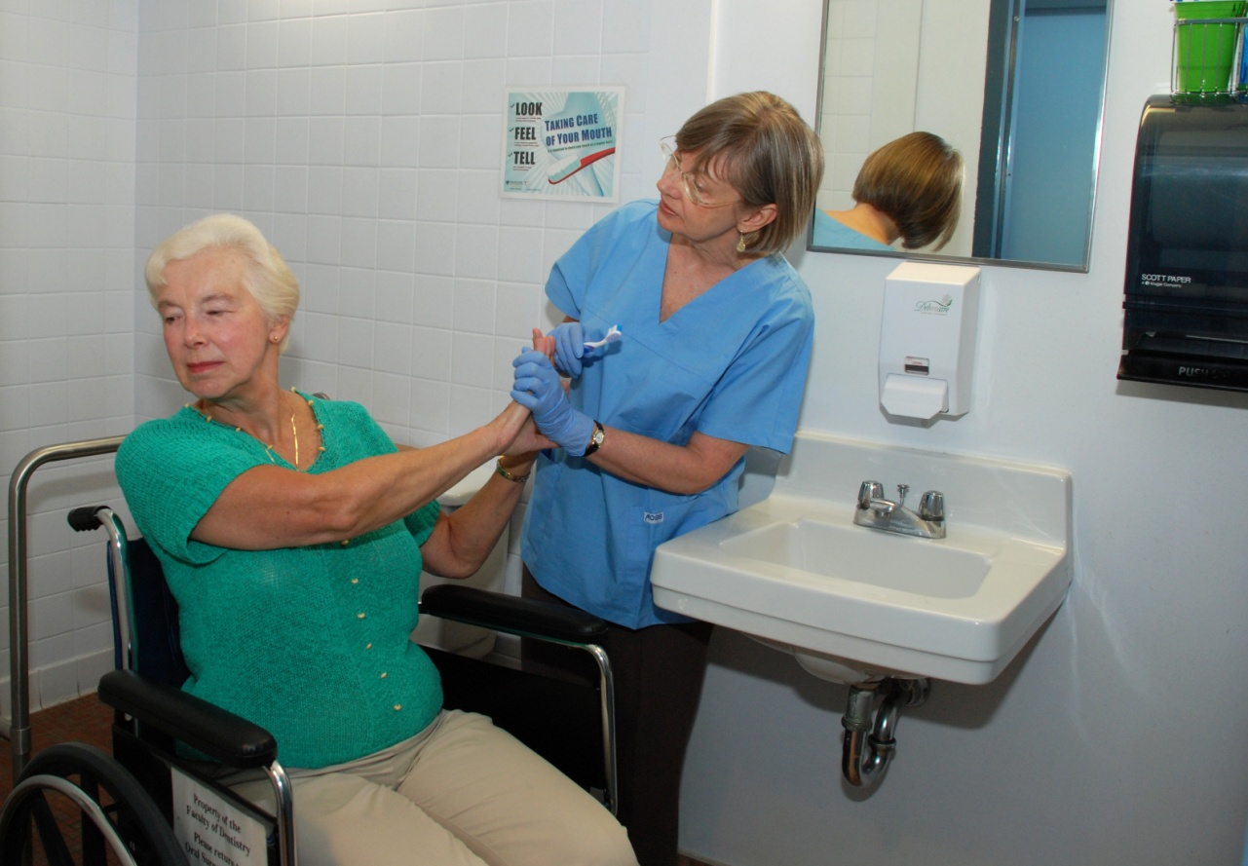
Session 3
‘Brushing Up on Mouth Care’
Education Series
Audience: Care Providers – CCAs, PCWs & HSWs
Considerations
for Dementia
Palliative Care
Notes:
The ‘Brushing Up on Mouth Care' program was developed through a research project at Dalhousie University (Faculty of Dentistry and the Atlantic Health Promotion Research Centre) and Capital District Health Authority. The project was funded by the Nova Scotia Health Research Foundation and the Canadian Institutes of Health Research.
To carry out this research project, researchers worked in partnership with personal care providers, nurse managers and directors of care from three long-term care facilities in rural Nova Scotia.
Together, the partners planned, developed, implemented and evaluated a daily oral care program for these facilities. The user-friendly resources that were created to educate and support personal care providers provide the basis for the "Brushing Up on Mouth Care' program.
This model provides a guide to the “Brushing Up on Mouth Care' education program. The overall objective of this program is to provide optimal mouth care for older adults who require assistance with personal care in both long term care and at home.
'Brushing Up on Mouth Care' focuses on assessment, care planning, education and resources. You will see these four themes come up throughout the various education sessions.

Slide 2
Session 3
‘Brushing Up on Mouth Care’
Education Series
Audience: Care Providers – CCAs, PCWs & HSWs
Permission for use of these materials is for educational purposes only. These materials may not be copied or republished in part or in whole in any form or by any means or media without prior permission from the Brushing Up on Mouth Care team.
Contact us at HPI@dal.ca or (902) 494-2240
Notes:
2
This is session one of the 'Brushing Up on Mouth Care' education series.
We will be discussing the basics of oral health, as well as oral care assessment and care planning.
**Introduce yourself
** Welcome participants

Slide 3
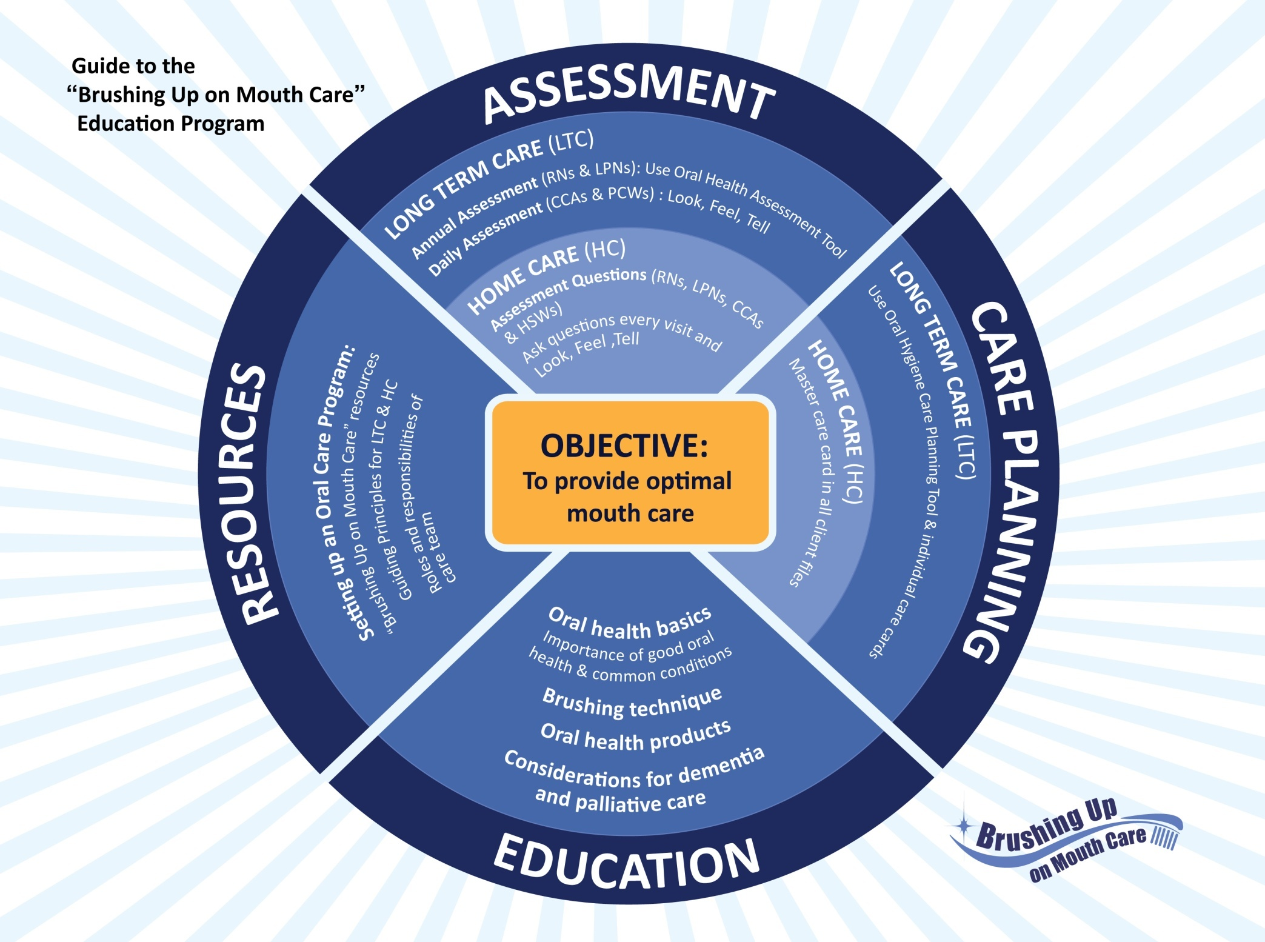
this education series we will cover four major themes including assessment, care planning, education and resources. This model outlines the four major themes.
Notes:
The 'Brushing Up on Mouth Care' program was developed through a research project at Dalhousie University (Faculty of Dentistry and the Atlantic Health Promotion Research Centre) and Capital District Health Authority. The project was funded by the Nova Scotia Health Research Foundation and the Canadian Institutes of Health Research.
To carry out this research project, researchers worked in partnership with personal care providers, nurse managers and directors of care from three long-term care facilities in rural Nova Scotia.
Together, the partners planned, developed, implemented and evaluated a daily oral care program for these facilities. The user-friendly resources that were created to educate and support personal care providers provide the basis for the 'Brushing Up on Mouth Care' program.
This model provides a guide to the 'Brushing Up on Mouth Care' education program. The overall objective of this program is to provide optimal mouth care for older adults who require assistance with personal care in both long term care and at home.
'Brushing Up on Mouth Care' focuses on assessment, care planning, education and resources. You will see these four themes come up throughout the various education sessions.

Slide 4
Session 3
Introductions
Logistics
Parking Lot
Introductions
Notes:
**Logistics:
Tell participants the session will take about a hour to complete.
Tell them where washrooms are located (if they are in an unfamiliar location).
Discuss any other logistics (e.g. turn off cell phones/pagers, breaks, etc.)
PARKING LOT:
The “Parking Lot” is a place to record any outstanding questions or issues that arise throughout the session.
Mark the words “Parking Lot” on one piece of paper, white board or flip chart.
Tell the participants that issues placed in the “parking lot” will be reviewed at the end of the session.
**If participants are not familiar with each other, go around the room and ask them to introduce themselves.

Slide 5
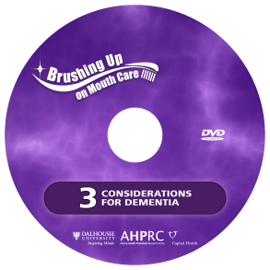
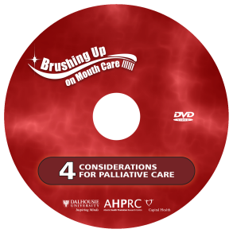
Overview
Session 3
Dementia
  Understanding dementia
  Tips and techniques for providing
  oral care
Assessment & Planning
  Importance of oral care during palliative care
  Providing oral care to palliative resident/clients
Conclusion
  Take Home Messages
Notes:
During this session we will discuss:
Dementia - what it is, and the challenges it presents when providing oral care
Tips and techniques to overcome some of these challenges
How oral care changes when caring for a palliative patient.

Slide 6
Session 3
Learning Objectives
This session will develop knowledge, understanding
and appreciation of:
  The impact of dementia as it relates to oral care
  Steps and processes for effective oral care
  Strategies for better communication
  How to manage challenging behaviour
  Oral conditions common to persons in palliative care
  Oral care modifications to ensure comfort
Notes:
This session will develop knowledge, understanding and appreciation of:
The impact of dementia as it relates to oral care
Steps and processes for effective oral care
Strategies for better communication
How to manage challenging behaviour
Oral conditions common to persons in palliative care
Oral care modifications to ensure comfort

Slide 7
Session 3
Oral Care for Residents/ Clients with Dementia
Session 3, Part 1
  What challenges do you face when providing oral care to a resident/client with dementia?
Notes:
More information on dementia and oral care can be found on video #3 of the 'Brushing Up on Mouth Care' video series.
Ask participants: What challenges do you face when providing oral care to a resident/client with dementia?
**Write participant challenges on flip chart or white board. Refer back to these challenges throughout the session.

Slide 8
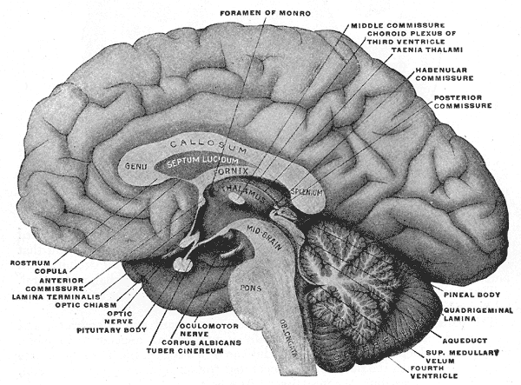
Session 3
Dementia
What is Dementia?
Progressive and ultimately terminal brain disease
People with dementia will exhibit unique symptoms
1 in 4 Canadians over 65 have some form of dementia
Notes:
Dementia is a progressive and terminal disease. Symptoms of dementia worsen over time.
While there is no cure for dementia, there are medications that may help with symptoms.
Dementia affects how a person interprets, interacts with, and responds to their social and physical environments.
As the disease progresses, people with dementia find it increasingly difficult to participate in activities of daily living.
People with dementia will exhibit unique symptoms.
There are several different types of dementia (Alzheimer’s disease is the most prevalent).
Dementia affects approximately 1 in 4 Canadians over the age of 65, and 2 out of 3 Canadians over the age of 85.

Slide 9
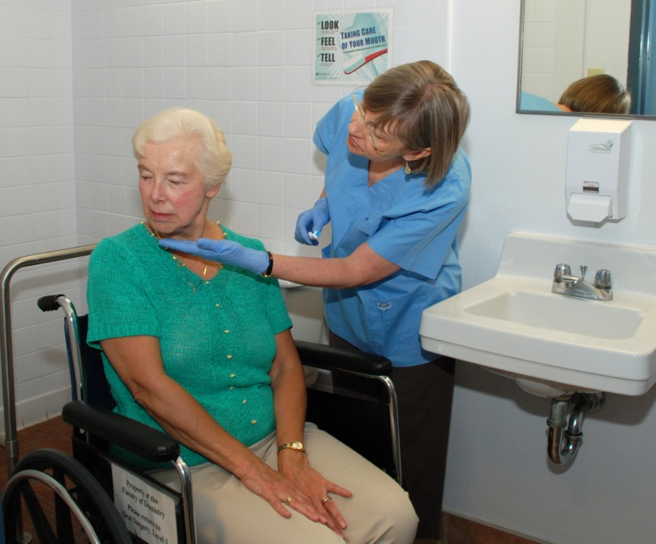
Session 3
Dementia
Common Losses
Memory
Language
Recognition of people, objects & sounds
Purposeful movement
Initiation
Altered perception
No knowledge of illness or disease
Notes:
Oral health is a very personal form of care. Therefore, it is important to develop an individualized approach for each resident/client in how you provide their oral care.
Care providers must take time to understand the behaviour of each resident/client and why they may be behaving a certain way. They should take the common losses of dementia into account when providing care. These losses include:
Memory
Language
Recognition of people, objects & sounds
Purposeful movement
Initiation
Altered perception
No knowledge of illness or disease

Slide 10
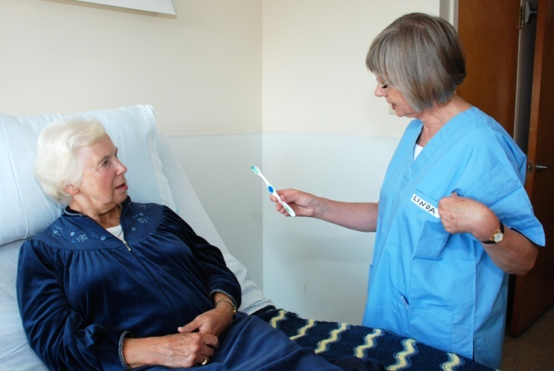
Session 3
Dementia
Addressing the Common Losses
Resident/client may be unaware they have dementia
  May not realize they require assistance
The resident/client may not remember who you are
  Introduce yourself
  Tell them what you are
  there to do
People with dementia
can unconsciously learn
by doing the same thing
every day
  Build a routine
Notes:
People with dementia can be unaware that they have a disease and therefore, may not feel that they require your help.
For example, they may appear angry with care providers trying to provide care, and may not appreciate that they need assistance.
Even though you may provide care to a resident/client everyday, they may not remember who you are.
It is important to introduce yourself each time you interact with them and tell them what you are there to do.
Encourage them to participate if they are able.
Keep in mind that mirrors may be distressing for these resident/clients as they may not recognize themselves.
Memory tends to be lost in reverse, so the last thing learned is the first thing lost.
This is why people with dementia can struggle to remember what happened this morning but have no trouble remembering information from many years ago.
So while people with dementia can no longer consciously learn, they can unconsciously learn by doing the same thing everyday. This reinforces the importance of a routine.

Slide 11
Session 3
Dementia
Addressing the Common Losses
People with dementia may have difficulty understanding what is said to them and communicating their needs
  Pay attention to body language
  Speak slowly and allow time for information to be processed
  Keep instructions simple
Always approach the resident/client from the front and at eye level
Engage the resident/client by initiating oral care
Notes:
People with dementia may have difficulty understanding what is said to them and communicating their needs to others. It is important to be in tune with body language cues and to be patient as they try to express themselves. For example, speak slowly to the person when engaging them in oral care and provide visual cues, like a toothbrush, to indicate what is about to take place. Allow time for information to be processed.
People with dementia often lose the ability to plan, sequence, and execute multiple steps of a task. They may require simple instructions broken down into each step involved in brushing their teeth. You may have to demonstrate each step in brushing your teeth. Do not assume that they can remember to do it at all or place it in the right sequence.
Depth perception is often altered resulting in changes in the way the person walks or sits and misinterpretation of objects in their environment (example: clothing on a chair is perceived to be a person). The resident/client may also lose their peripheral visual field and focus on what is in front of them. They may startle easily when approached from behind or from the side. Always approach someone with dementia from the front and at eye level.
People with dementia may no longer have the ability to initiate conversation or activities, but may do so if someone tries to engage him or her. Keep this in mind when attempting to provide oral care. Initiate the activity of brushing the resident/clients teeth and they may be able to complete the activity on their own.

Slide 12
Session 3
Dementia
Responsive Behaviours
All behaviour has meaning
  Response to a trigger in person’s environment
  Triggers vary from person to person
  Medication or pain
Consider the environment
  Provide a calm and quiet environment for oral care
  Loud noises & poor lighting can be distressing
  Lack of meaningful activity
Consider your timing
  Providing care after a meal may be better for some
  Try to be consistent (i.e. at the same time each day)
Notes:
As the brain loses its ability to process information the person will rely heavily on cues from their environment and may react without the ability to think through a situation or problem solve to determine appropriate actions.
All behaviour has meaning.
Care providers should be attentive to the behaviour of a person with dementia. Their behaviour is conveying an important message and is usually in response to a trigger in their environment. The environment includes the physical space and the people in it.
Triggers will vary from person to person. They may include things like a person talking loudly, a ticking clock, bright lights, a dripping faucet, etc.
Behaviours could also be the result of certain medications or pain.
Consider the person’s environment.
Provide a calm and quiet environment when doing oral care.
Engaging resident/clients in meaningful activity can decrease responsive behaviours.
Consider your timing.
Some resident/clients/clients may be more receptive to oral care after a meal when they feel satisfied and relaxed.
Consistency helps to establish routine.
The more you understand the possible cause of a behaviour, the better equipped you are to create a positive interaction with the person.

Slide 13
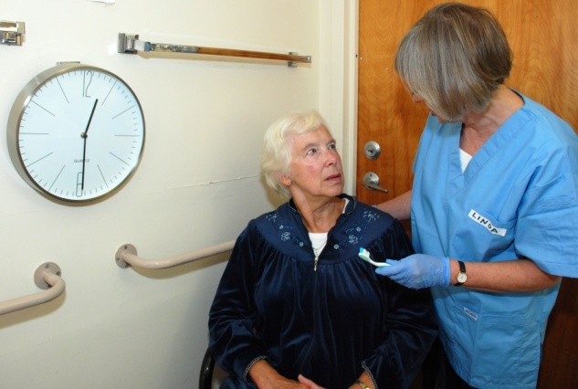
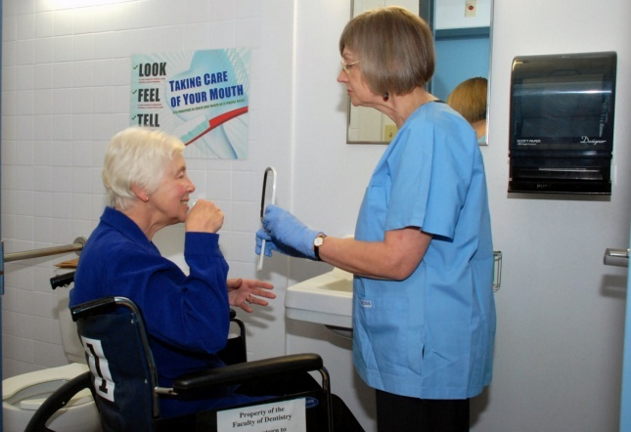
Session 3
Dementia
Tips for Providing Oral Care
Always ask for permission before providing oral care
Let the person participate in their own care whenever possible
  Improves adherence
  Assist in other ways
Set a routine time and place
for oral care
Notes:
1) Always ask for permission before providing oral care
It is important to get consent from the resident/client before providing care. Remember to introduce yourself and tell them what you are there to do.
2) Let the person participate in their own care whenever possible
Often, people with dementia are perceived as being unable to perform their own oral care; however, with some guidance, changes to their environments, or modifications to their oral health tools, some people may be able to complete oral care activities by themselves.
It is always best to allow a resident/client to complete his or her own care if possible – even if you do not feel they are doing a good job. Adherence to daily oral care practices is more likely when the resident/client participates in their own care.
They may need assistance with setting up, cleaning up, turning the water on and off, or putting toothpaste on the brush. They may also need guidance in the mouth with brushing and may need verbal cues to rinse and spit.
3) Set a routine time and place to provide oral care.
The familiarity of a routine may decrease resistance over time.
Gather all of the necessary supplies ahead of time. If possible, provide oral care in the bathroom. This environment will help to serve as a cue for oral care.
Set up oral care supplies even if the resident/clients is refusing oral care.
Do not wake a resident/client to provide oral care. This may increase confusion and lead to resistance or responsive behaviour.

Slide 14
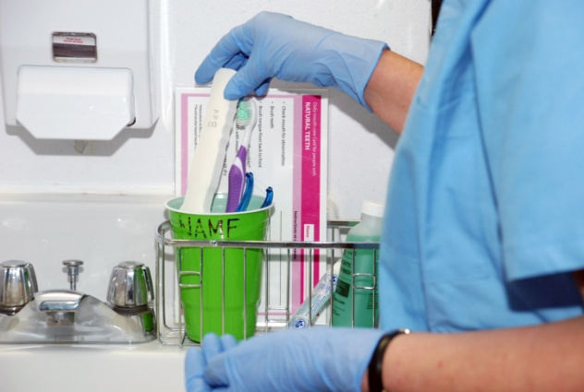
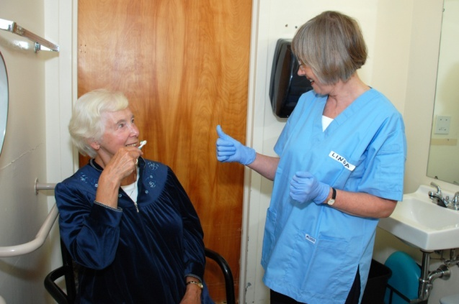
Session 3
Dementia
Tips for Providing Oral Care
Ensure appropriate environment and supplies
Be positive in and reassuring in your actions and words
  Speak slowly and clearly
  Use non-verbal cues
  Give lots of praise
Approach at eye level and from the front
Notes:
4) Ensure appropriate environment and supplies
Check the resident/client’s physical environment - Is something preventing the resident/client from performing their own care? For example, the resident/client may have trouble reaching the sink. If there are concerns, try to think of possible solutions - use a kidney basin if they cannot reach the sink, provide a hand-held mirror if they need to see while doing oral care procedures.
Make sure the environment is calm and quiet with few distractions.
Ensure all oral care supplies are labeled, including the resident/client’s toothbrush, dentures, and denture brush.
5) Be positive in and reassuring in your actions and words
Speak slowly and clearly. Ask only one question at a time and provide only one instruction at a time.
Use non-verbal cues such as smiling, gentle touch, or having the resident/client hold their toothbrush while you set up the supplies.
Always use a positive approach - start by showing the resident/client what to do and then coach and encourage them through each step.
Give lots of praise and positive reinforcement.
You may have to distract the resident/client in order to provide oral care. For example, it may help to sing, or count or provide the resident/client with a toothbrush or a face cloth to hold while you brush their teeth or dentures.
6) Approach the resident/client at eye level and from the front
While the Ideal position for providing oral care is to stand beside or slightly behind the resident/client, it may not be appropriate when providing care for someone with dementia.
Because their peripheral vision may be impaired, positioning yourself beside or behind the resident/client may make them nervous, confused, or uncomfortable.
Position yourself in front of the resident/client to provide oral care. If the resident/client is sitting, approach them at eye level to appear less threatening.

Slide 15
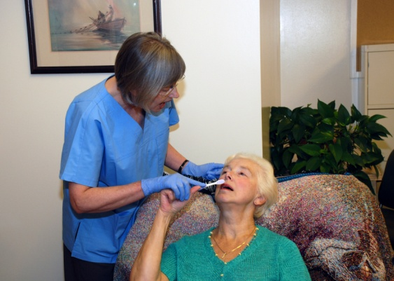
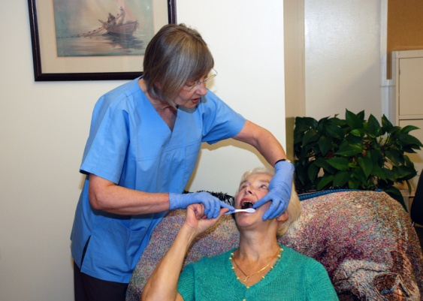
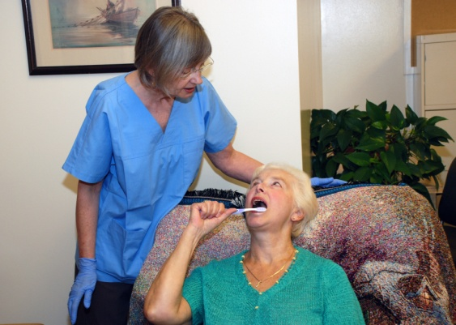
Session 3
Dementia
Techniques for Providing Oral Care
Hand over Hand: place your hand over the resident/client’s hand and guide them
Chaining: start brushing the resident/client’s teeth then let them take over
Distraction: hum, sing, talk or give the resident/ client something to hold to distract them during care
Notes:
Sometimes, it may take a little ‘something extra’ to ensure a resident/client receives adequate oral care. We will now review some other techniques for consideration.
Hand-over-hand technique:
The hand over hand technique allows the resident/client to feel as if they are providing their own oral care.
The care provider places their hand over the resident/client’s hand and guides them through the brushing procedure.
Chaining:
Chaining goes a step beyond the hand-over-hand technique.
When a care provider starts the oral care procedure and then the resident/client takes over and finishes the process, this is referred to as chaining.
The care provider can place toothpaste on the toothbrush, put it in the resident/client’s hand and assist the resident/client to place the brush in their mouth and brush their teeth.
Once the care provider feels the resident/client is in control of the procedure, they can let go of their hand and allow them to finish brushing on their own.
Distraction method:
The distraction method is used to distract the resident/client during oral care.
The care provider can sing, hum, talk, or gently touch the resident/client. If the resident/client is grabbing at things with their hands give them a facecloth to hold in each hand to keep them busy.
**Ask a volunteer from the audience to help you demonstrate these techniques.

Slide 16
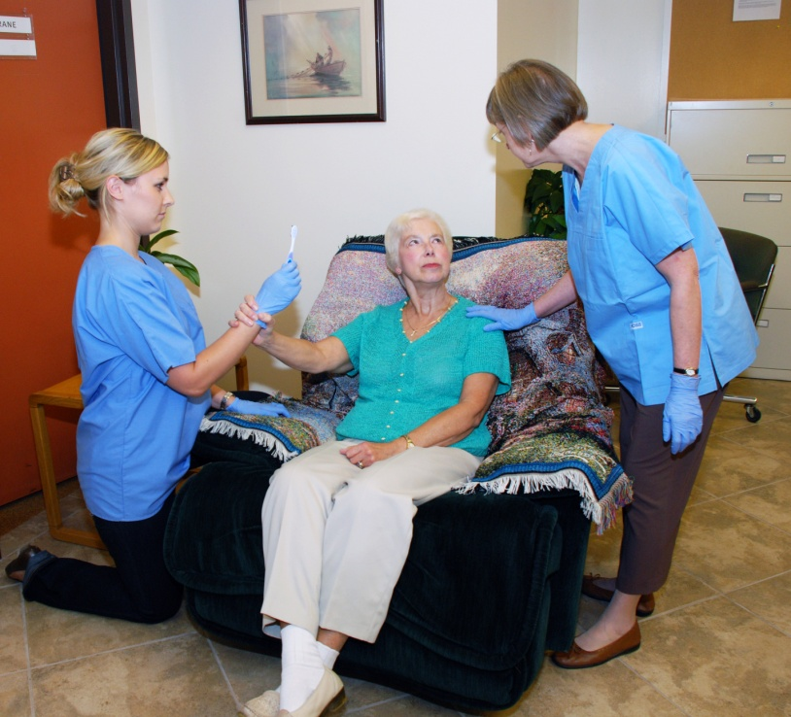
Session 3
Dementia
Techniques for Providing Oral Care
Bridging:
resident/client holds a toothbrush
Rescuing:
second care provider comes to relieve the first care provider, seen to be ‘rescuing’ the resident/ client from the stressful situation
Notes:
Bridging technique:
Bridging is a variation of distracting.
Bridging occurs when the resident/client is asked to hold the same object as the care provider, such as a toothbrush, and then holds this object while oral care is being performed.
Rescuing:
When a care provider is experiencing difficulties with a resident/client it may be necessary for a second care provider to relieve the first care provider.
The resident/client is told that the second care provider is there to help.
This may encourage the resident/client to like and trust the second care provider.
The second care provider will then take over the oral care procedure.
**Ask volunteers from the audience to help you demonstrate these techniques.

Slide 17
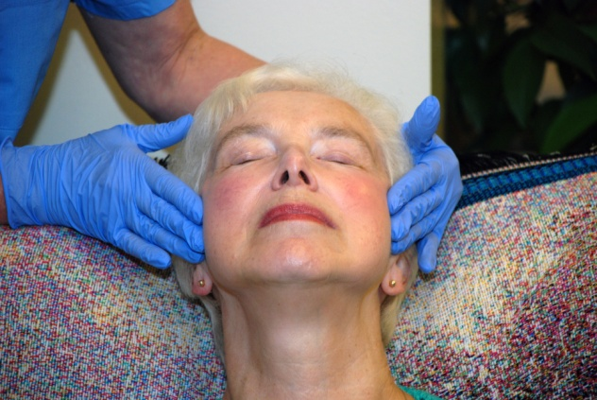
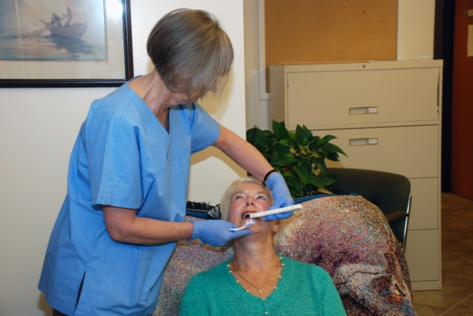
Session 3
Dementia
Accessing the Mouth
Ask for consent
Verbally coax
Massage cheeks
(over TMJ) to relax
the muscles and encourage opening
Use a mouth prop
Notes:
It is important that you have consent from the resident/client to perform oral care. The resident/client has a right to refuse care. If you are having trouble getting the resident/client to open their mouth, try first to verbally coax them to open.
If the resident/client is having difficulty opening their mouth, try massaging the cheeks and joints to relax the muscle and encourage opening.
A soft mouth prop can gently hold the resident/client’s mouth open while you brush their teeth. This can be useful if the resident/client has difficulty opening their mouth wide or holding their mouth open.
Mouth props can also provide peace of mind to care providers who are fearful of having their fingers bitten.
Mouth props can be labeled, cleaned and reused.
To use a mouth prop, wiggle the prop between the back teeth, then turn the prop so the wider portion allows the mouth to open more.
If a mouth prop is unavailable, you can use several tongue depressors taped together, or the handle of another toothbrush or to prop the resident/client’s mouth open – this is called the two-toothbrush technique.

Slide 18
Session 3
Dementia
Group Activity
Mrs. Anderson
You approach Mrs. Anderson and offer to help her brush her teeth. She agrees and when you take the toothbrush and put it to her mouth she grabs at it.
What techniques could you employ to continue to assist Mrs. Anderson?
Mrs. Beaton
Mrs. Beaton is in the bathroom with you and you are helping her brush her teeth. You find it hard to keep her attention and other items in the bathroom easily distract her.
What techniques could you employ to keep her on task and continue to support her oral care?
Notes:
**Group activity:
There are two scenarios on this slide.
Participants are asked to divide into two groups to discuss which of the techniques they might use in each scenario.
Have the Right side of the room discuss Mrs. Anderson’s scenario and the Left side of the room discuss Mrs. Beaton’s scenario.
Encourage participants to share their experiences with using the techniques and whether they have been successful.

Slide 19
Session 3
Dementia
Transitioning to palliative care
Dementia progresses in stages
For people in the very severe stages of dementia (i.e. end stage) who are completely dependent on others it may be appropriate to transition to palliative oral care routines
Notes:
Dementia progresses in stages
For people in the very severe stages of dementia (i.e. end stage) who are completely dependent on others it may be appropriate to transition to palliative oral care routines
**This is the last slide for Dementia.
Any questions about dementia before we move onto palliative care?
**Break? If you wish, you may take a 5-10 minute break OR you may continue to the next section on Palliative Care.

Slide 20
Session 3
Oral Care for
Palliative Patients
Session 3, Part 2
  What challenges have you experienced when providing oral care to palliative patients?
Notes:
More information on oral care for palliative patients can be found on video #4 of the 'Brushing Up on Mouth Care' video series.
** Ask participants: What challenges have you experienced when providing oral care to palliative patients?
**Write participant challenges on flip chart or white board. Refer back to these challenges throughout the session.

Slide 21
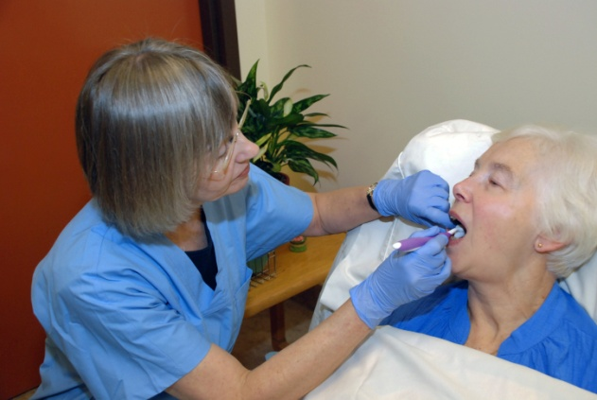
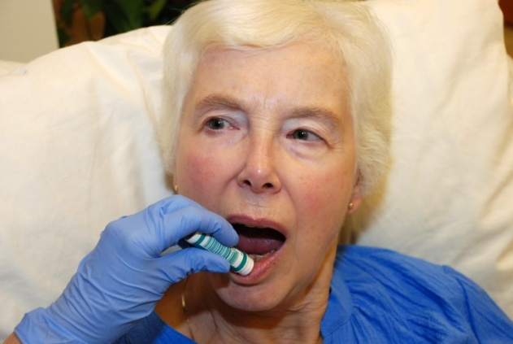
Session 3
Palliative Care
Overview
What is palliative care?
Oral care for the palliative patient
Symptoms and treatments for common oral conditions
Tips and products for delivering daily oral care
Notes:
Here is an overview of what we will discuss during this session on palliative care:
What is palliative care?
Oral care for the palliative patient
Symptoms and treatments for common oral conditions
Tips and products for delivering daily oral care

Slide 22
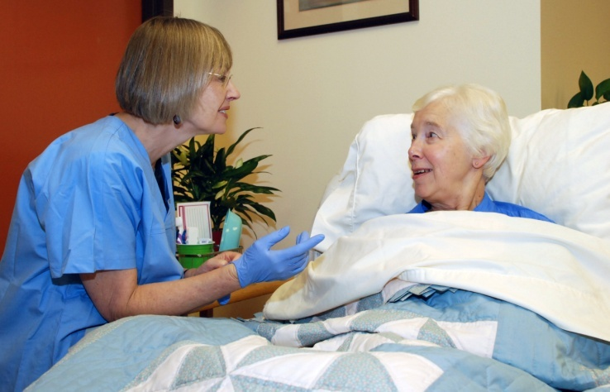
Session 3
Palliative Care
What is Palliative Care?
Care at the end of life
Care for people with terminal illness, advanced frailty, and/or chronic diseases
Focuses on comfort,
pain management and
symptom control
Improves end of life
Notes:
Palliative care aims to improve end of life by relieving pain and promoting comfort. It focuses on alleviating symptoms.
Many older adults suffer from terminal illnesses, advanced frailty and chronic diseases which requires us to apply goals to ensure optimum comfort in the months and years preceding end of life.
Palliative care focuses on comfort, pain management and symptom control
Care providers play a major role in alleviating fear and stress associated with end-of-life care. This is often an emotional time for both patients and families.

Slide 23
Session 3
Palliative Care
Objectives of Palliative Oral Care?
Manage oral pain
Maintain comfort
Promote dignity and self-esteem
Palliative patients are particularly susceptible to ulcerations, infections, dryness, tooth decay, and coatings affecting mouth tissues
Notes:
Daily oral care is important for palliative patients.
The objectives of palliative oral care include:
Managing oral pain
Maintaining comfort, and
Promoting dignity and self-esteem
Palliative patients are particularly susceptible to ulcerations, infections, dryness, and coatings affecting mouth tissues. They are also at a higher risk for tooth decay. These are all sources of oral pain and discomfort.
Oral pain can be devastating. It affects a patient’s ability to eat and speak.
It is important to be diligent in providing oral care and evaluating oral care needs on a daily basis. Oral health problems can develop very quickly and result in rapid deterioration of a patient’s overall health.
Having a clean mouth free of unpleasant odor may also improve a patient’s self-esteem and sense of overall wellness.

Slide 24
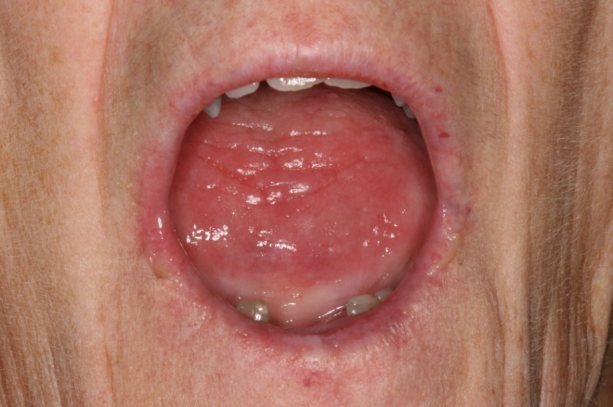
Session 3
Palliative Care
Common Conditions
Dry mouth/cracked lips:
  CAUSES: medications; genetic disorders and other medical
  conditions (e.g. diabetes); mouth breathing;
  dehydration
Symptoms:
  Difficulty swallowing, chewing, and speaking
  Bad breath or hoarseness
Treatment:
  Increasing fluid intake
  Sucking on ice cubes or
  sugar-free candy
  Saliva substitutes
  Room humidifier
Notes:
Dry mouth and cracked lips are very common in frail elderly and palliative patients and is often caused by chronic dehydration.
SYMPTOMS:
Symptoms of dry mouth include: difficulty swallowing, chewing, and sometimes even speaking. It can also cause bad breath or hoarseness.
A dry mouth is an optimal breeding ground for plaque and bacteria. This can lead to increased tooth decay, gum disease, and burning mouth syndrome.
TREATMENT:
Depending on the severity, treatment of dry mouth can be as simple as increasing fluid intake by drinking water and/or sucking on ice chips. Whenever possible, monitor fluid intake to ensure that patients are not at risk for dehydration.
If appropriate for the patient, sugarless lemon candy or sugar free gum can increase saliva production in the mouth.
Dry mouth products, including toothpastes, rinses, and saliva substitutes are available commercially and a pharmacist or dental professional can assist with choosing these products.
A room humidifier may also be useful to moisten the air for mouth breathers.

Slide 25
Session 3
Palliative Care
Common Conditions
Candida Infection/Thrush/Candidiasis:
    Fungal overgrowth
    Occurs on soft palate, gum tissue and tongue
  CAUSES: body is run down; improper denture care;
  dry mouth; certain medications
Symptoms:
  White creamy patches & small red dots (usually not painful)
Treatment:
  Treatment by antifungal agent (must be prescribed by dental or medical professional)
  Disinfect dentures and discard any oral care tools that have come in contact
Notes:
Candidiasis is an infection that causes a fungal overgrowth to accumulate in the mouth, usually on the gum tissue, tongue and soft palate.
CAUSES
It is likely to occur when the body is run down. Patients who are on antibiotics, immunocompromised, receiving chemotherapy, or diabetic are at the highest risk for this type of infection.
If dentures remain in the mouth for extended periods of time, underlying tissues are not able to be cleansed naturally with saliva or through brushing and rinsing. Dentures should be removed daily for cleaning and to allow mouth tissues to rest.
Dry mouth and certain medications can also trigger candida infection.
SYMPTOMS:
This condition appears as white creamy patches or small red dots. It is usually not painful, although sometimes the underlying tissue is raw and may even bleed.
TREATMENT:
Treatment with an antifungal agent is possible but must be prescribed by a dentist or a doctor.
Disinfect or discard any oral care tools that were exposed to the infected tissue.
Soak dentures in a solution of vinegar and water to eliminate any cross contamination. Dentures that do not contain metal can also be disinfected by soaking them in a mild bleach solution (1 part bleach to 15 parts water).

Slide 26
Session 3
Palliative Care
Common Conditions
Angular Cheilitis:
    Chronic, painful condition in corners mouth
    Occurs in people who have lost some or all teeth
  CAUSES: poor nutrition; fungal or bacterial infection;
  constant licking, drooling or pooling of saliva
Symptoms:
  Red ulcerative patches in corner of mouth
Treatment:
  Treatment by antifungal agent
  Improved nutrition
Notes:
Angular Cheilitis (CHEE – LIE – TIS) is a chronic painful condition that occurs in the corners of the mouth.
CAUSES:
It is often seen in people who have lost some or all of their teeth. Constant licking of the lips, drooling or pooling of saliva often cause angular chelitis. Poor nutrition and fungal or bacterial infections can also contribute to this condition.
SYMPTOMS:
It appears as red and ulcerated patches in the corners of the mouth. It can make it very painful to open the mouth which can impact eating, drinking and speaking.
TREATMENT:
Treatment with antifungal agents and improving overall nutrition can help alleviate the problem.

Slide 27
Session 3
Palliative Care
Tips for Daily Oral Care
Assess daily
Ensure the mouth is moist and promote hydration
Remove and clean dentures daily
  Remove for a minimum of 1 hour
  Ensure dentures are moistened before placing back in the mouth
Notes:
Here are some tips for providing daily oral care to palliative patients:
Assess the patients needs daily. Identify risks of any oral conditions and set a daily oral care plan. Record and report any issues.
As I’ve already mentioned, ensuring the mouth is moist and the patient is hydrated is important for mouth comfort.
Remove and clean dentures at least once per day.
Ideally, dentures should not be worn wile sleeping.
Leave dentures out for a minimum of one hour to allow mouth tissues to rest.
Moisten the denture before placing back into the patient’s mouth. A water soluble lubricant, like a saliva substitute, placed under the denture can also improve comfort.

Slide 28
Session 3
Palliative Care
Tips for Daily Oral Care
DO NOT use:
alcohol-based mouth rinses
oral swabs
petroleum-based products
DO use:
saline, soda water or fluoride rinses
a soft toothbrush
non-petroleum, water soluble moisturizer
saliva substitute 2-6 times daily
Notes:
The most important goal in providing mouth care to palliative patients is to maintain optimal oral hygiene with a minimum discomfort.
Avoid mouth washes that contain alcohol, as they will dry out the mouth and irritate the gums. Instead, rinse with saline, soda water or neutral fluoride rinse after every meal or use a moist gauze to wipe out leftover food from the cheeks and under the tongue.
Do not use oral foam tip swabs. These swabs usually just move the food around the mouth without actually removing it. Lemon or glycerin swabs should be avoided because they can also have a drying effect on the gum tissues.
It is best to use an ultra soft toothbrush twice a day with a very gentle brushing or patting action. Firm bristles can tear gum tissue and cause bleeding.
Avoid petroleum-based products for lip care. Petroleum products actually cause tissues to dry out. Apply a non-petroleum, water soluble moisturizer to the lips 2-6 times daily as needed. These types of lubricants are available commercially.
Saliva substitutes 2-6 times daily may also help to keep the mouth moist.
**This is the last slide for Palliative Care. Next slide outlines ‘Take Home Messages’

Slide 29
Session 3
Conclusions
Take Home Messages
DEMENTIA
Build an oral care routine
- try everyday
Be positive and encouraging
Include the resident/client in their own oral care whenever possible
PALLIATIVE CARE
Focus on minimizing overall mouth pain/discomfort
A clean comfortable mouth contributes to self esteem /dignity
Notes:
Canadians are living longer than ever before. We are already seeing an increased prevalence in dementia as the population ages. People are also aging and retaining their natural teeth. This will present a new set of challenges to those responsible for their care.
DEMENTIA
Oral care for those with dementia may not be possible everyday; however, it is important to try everyday.
A resident/client who often refuses oral care may see your continued attempts to provide care and eventually accept oral care as part of the routine you have established.
Be positive and encouraging in your words and actions.
Be sure to include resident/clients in the oral care process as much as they are able.
PALLIATIVE CARE
Palliative oral care focuses on minimizing overall mouth pain and discomfort.
Helping patients to communicate effectively, and eat and drink free of pain is important for maintaining the best quality of life possible.
A clean comfortable mouth contributes to self-esteem and dignity for those who are approaching the end of life.

Slide 30
Session 3
QUESTIONS?
Notes:
Any additional questions before we wrap up?
**Check the “Parking Lot” for lingering issues and questions and address them now.

Slide 31
Session 3
Learning Objectives
Did we meet the learning objectives?
This session will develop knowledge, understanding and appreciation of:
  The impact of dementia as it relates to oral care
  Steps and processes to develop an effective oral care
  Strategies for better communication
  How to manage challenging behaviour
  Oral conditions common to persons in palliative care
  Oral care modifications to ensure comfort
Notes:
Ask participants if they feel they have met the learning objectives.

Slide 32
Session 3
Next Steps
The fourth (and final) session on implementing an oral care program will be offered to all members of the care team and administrators
Notes:
The fourth (and final) session on implementing an oral care program will be offered to all members of the care team and administrators
This session will discuss how to implement an oral care program using the 'Brushing Up on Mouth Care' resources.
Guiding principles for oral care will also be outlined.

Slide 33
Session 3
‘Brushing Up on Mouth Care’
Education Series
Audience: Care Providers – CCAs, PCWs & HSWs
THANK YOU!
Notes:
Distribute session evaluation forms
Leave a large envelope for participants to place completed forms.
Leave the room for 5 minutes to permit participants to submit anonymous evaluation forms.

